Slide 1
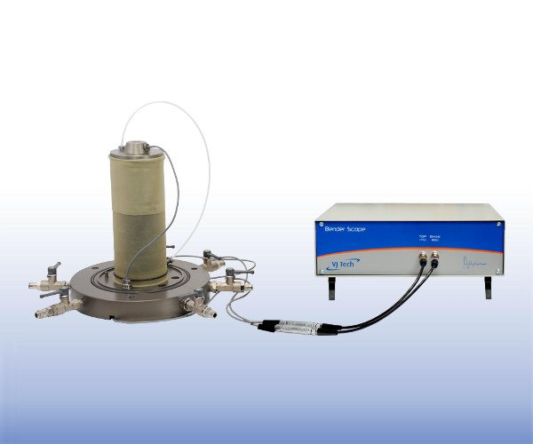
Bender Element Test
Working Principle
Shear wave is transmitted through the soil sample using the Piezo-electric bender and shear wave velocity is measured.
Application
Small strain shear modulus (G_{max}) can be determined from this test.
Bender Element Apparatus

Slide 2
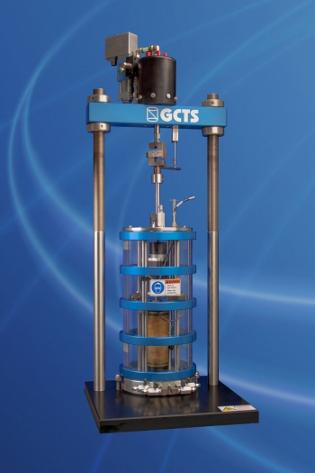
Resonant Column Test
Working Principle
Harmonic torsional excitation is applied to the cylindrical soil specimen and the loading frequency is gradually increased from low value until the strain amplitude attains a maximum. Free vibration decay is tracked.
Application
Resonant column apparatus
To determine the dynamic soil properties such as low-strain shear modulus and damping ratio.

Slide 3
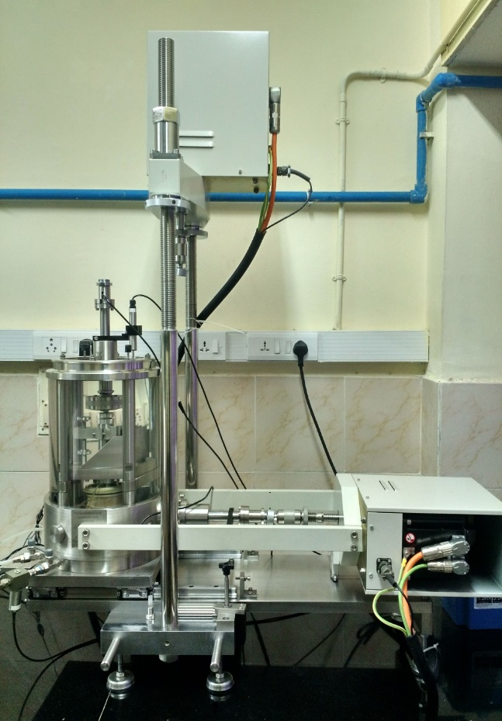
Cyclic Simple Shear Test
Working Principle
A cylindrical sample enclosed in a rubber membrane/steel rings is consolidated and then sheared under constant volume condition. Cyclic/Monotonic shear loading is applied in horizontal direction while the normal stress imparted in vertical direction.
Application
To determine the dynamic properties of soil at large-strain levels.
To study liquefaction potential of soils.
Cyclic simple shear apparatus

Slide 4
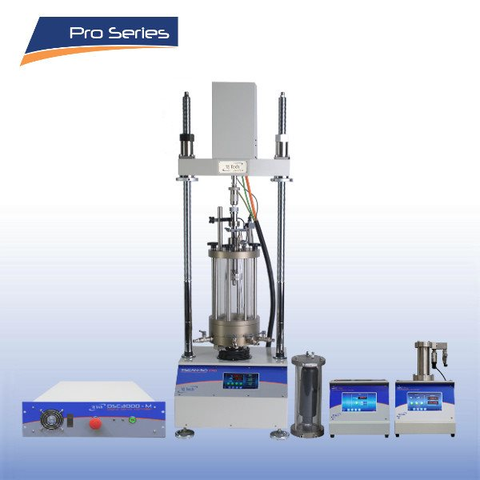
Cyclic Triaxial Test
Working Principle
A cylindrical soil sample enclosed in a rubber membrane is consolidated and subjected to cyclic loading in vertical direction.
Application
To study stress-strain behaviour of soil in large-strain range.
To evaluate liquefaction potential of saturated soils.
Cyclic Triaxial apparatus

Slide 5
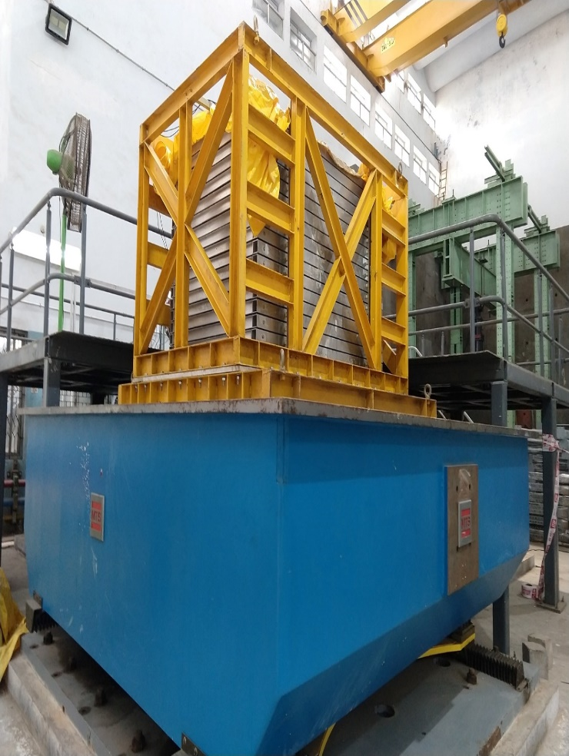
Shake table test
Working Principle
A soil specimen is constructed within a stack of laminates forming a flexible container, mounted on shake table along with the rigid box. Seismic or other loading signals is applied to the table and the response of the soil specimen is measured via instrumentation.
Application
To study the seismic response of scaled soil models, with structures if any.
To investigate the effectiveness of ground treatment strategies under seismic loading.
Laminar shake table test apparatus

