Slide 1
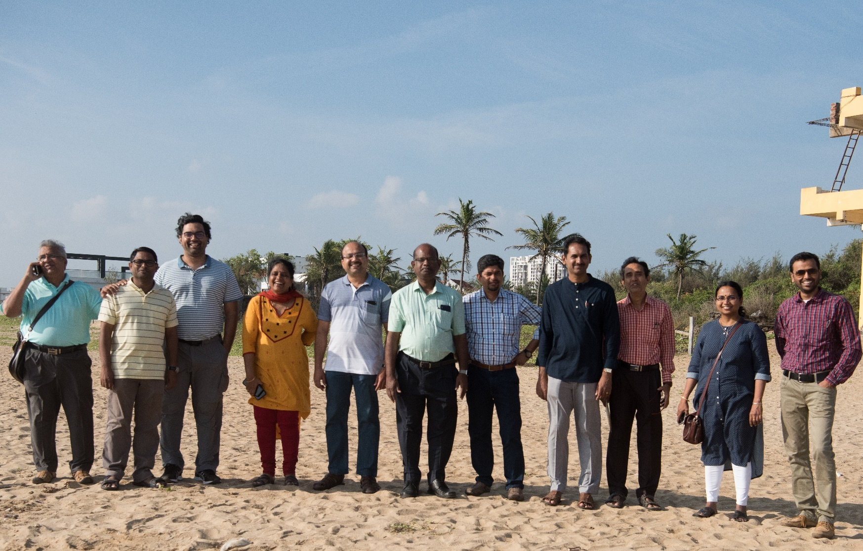
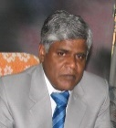
WELCOME TO
ENVIRONMENTAL WATER RESOURCES ENGINERING (EWRE) LABORATORY

Slide 2
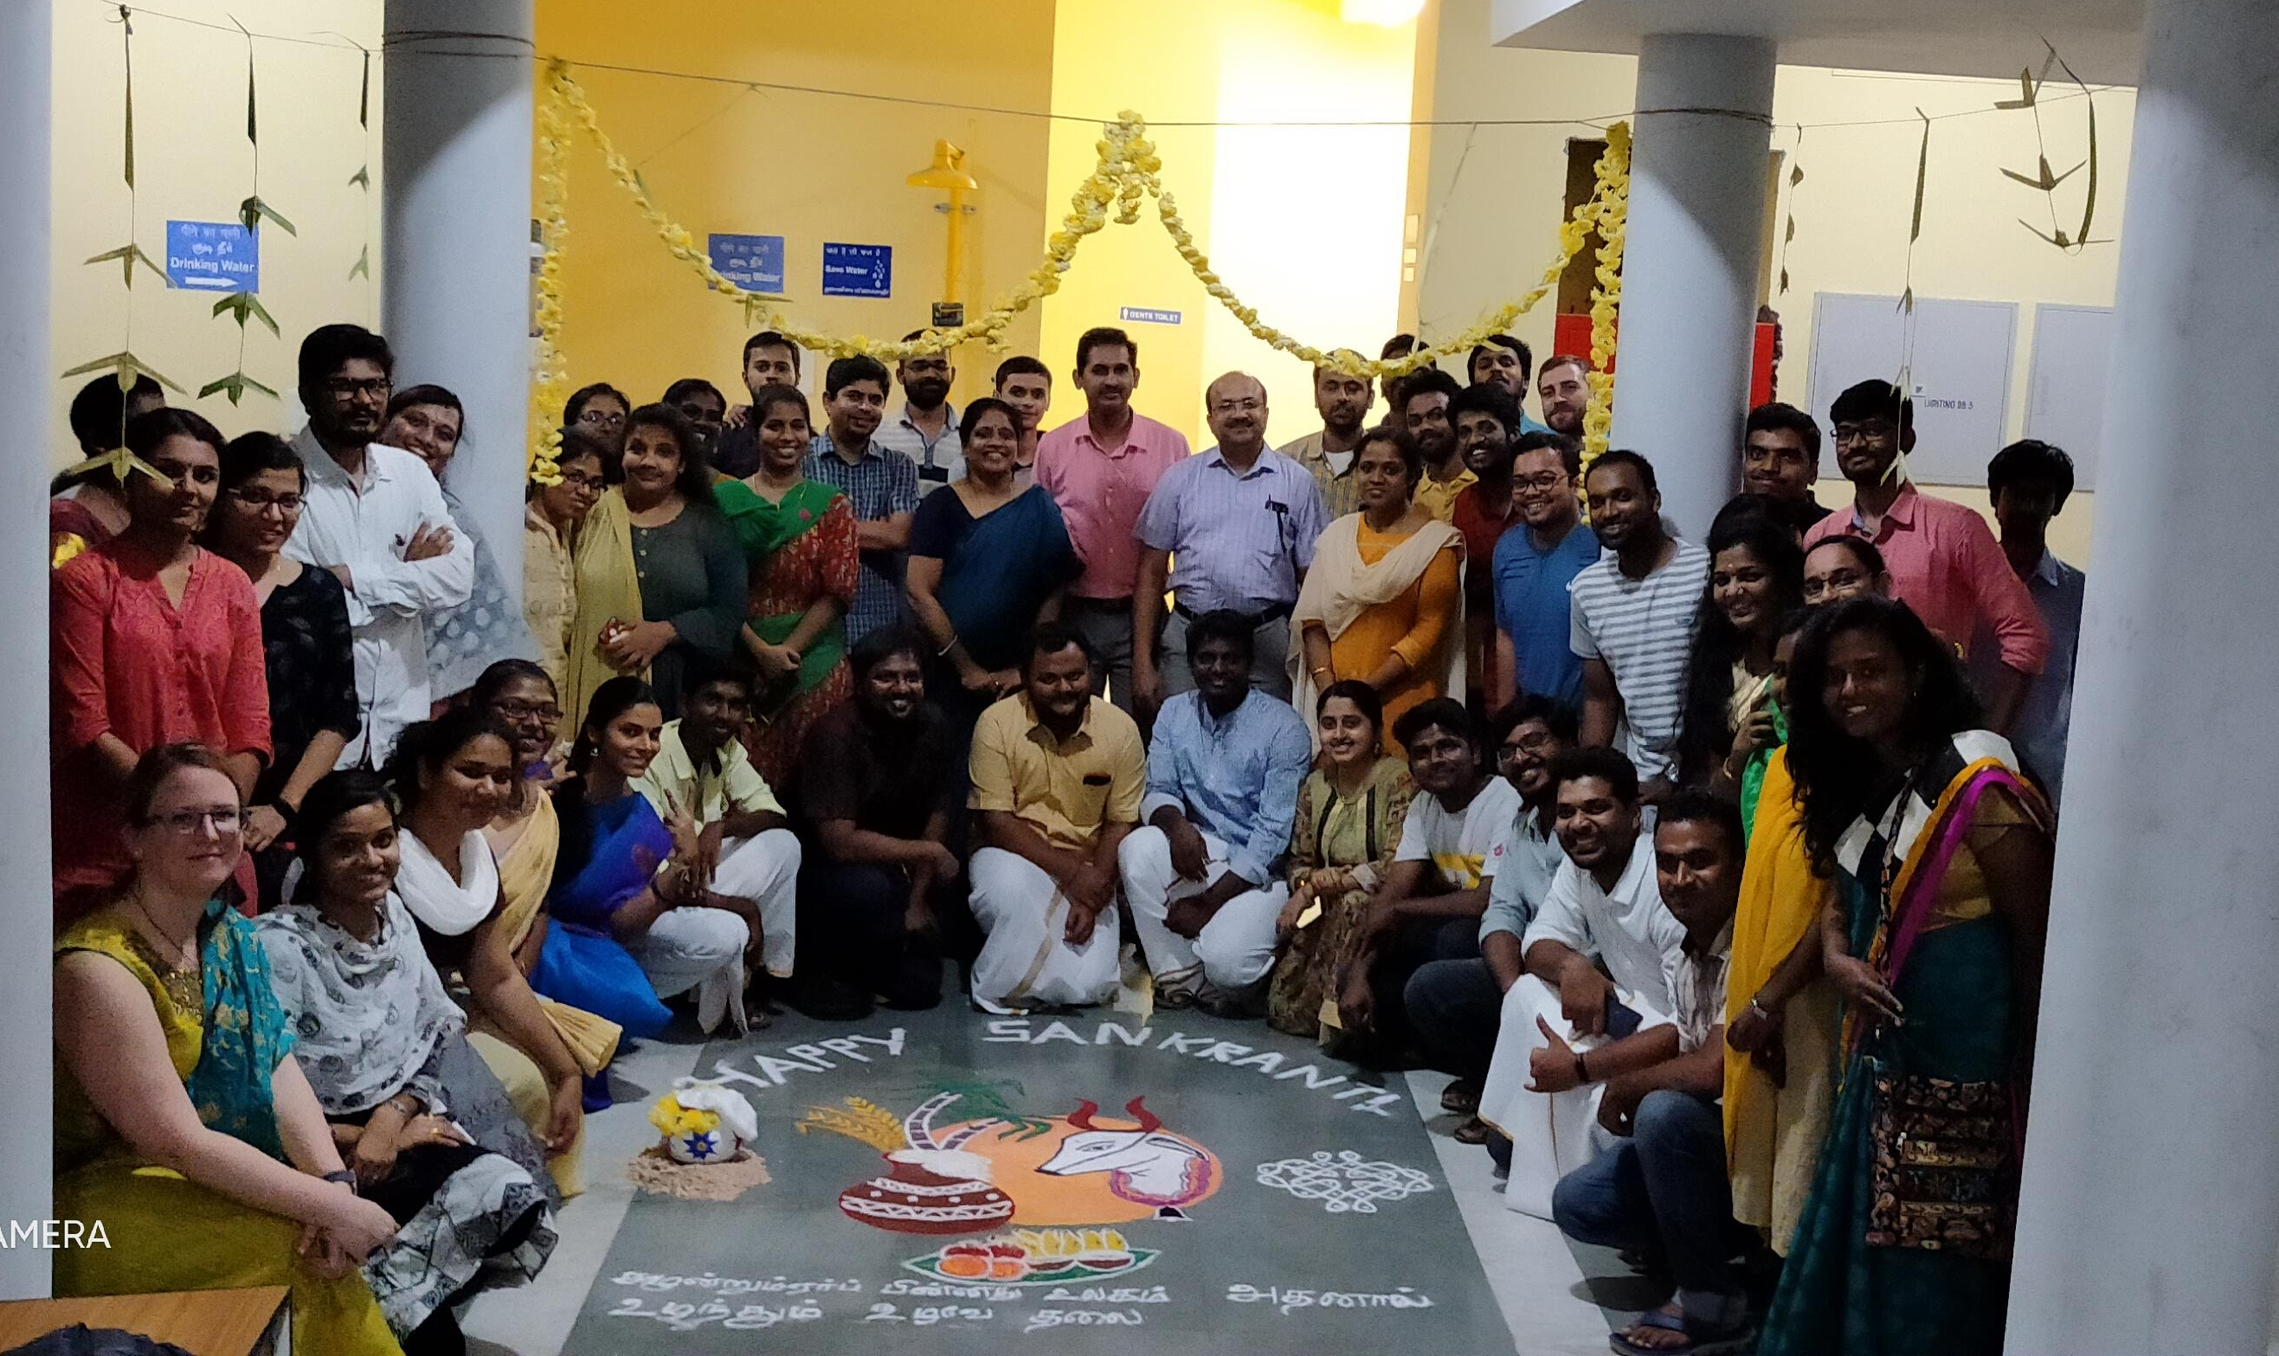
Our Students

Slide 3
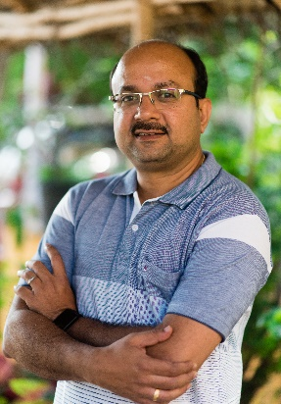
Dr. Balaji Narasimhan
Ph.D, Texas A&M University, USA
Professor, Dept. of Civil Engineering
044-2257-4293; nbalaji@iitm.ac.in
http://www.civil.iitm.ac.in/balaji_edu
Remote Sensing and GIS
Hydrological Modeling
Irrigation water management
Crop Evapotranspiration, Inter-basin water transfer, Irrigation efficiency
Floods & droughts extent, magnitude, duration and frequency
Impact of climate and land use changes on the water resources
Hydrologic Modelling for effective management of land and water resources

Slide 4
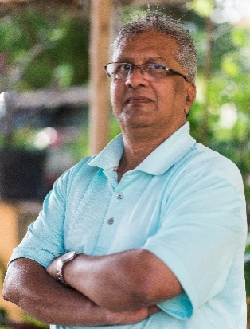
Dr. B. S. Murty
Ph.D, Washington State Univ., Pullman, USA
Professor, Dept. of Civil Engineering
044-2257-4262; bsm@iitm.ac.in
http://www.civil.iitm.ac.in/murty_edu
Open-Channel Flow Modeling
Closed Conduit Flows
Groundwater Resources Management
Analysis of steady and transient flows in pipe systems, optimal design, condition assessment
Simulation and management models for groundwater resources utilization and aquifer remediation
Modeling of flow and transport of pollutants in open channels for quantity and quality management
Computational Hydraulics for Management of Water Resources

Slide 5
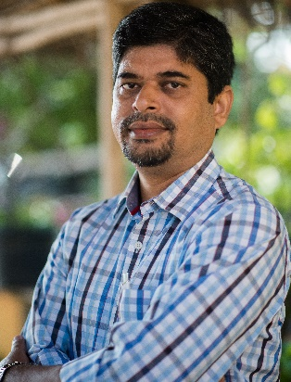
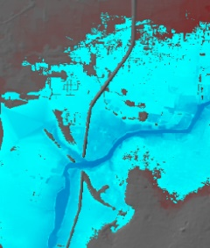
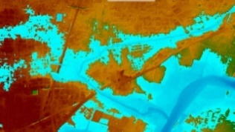
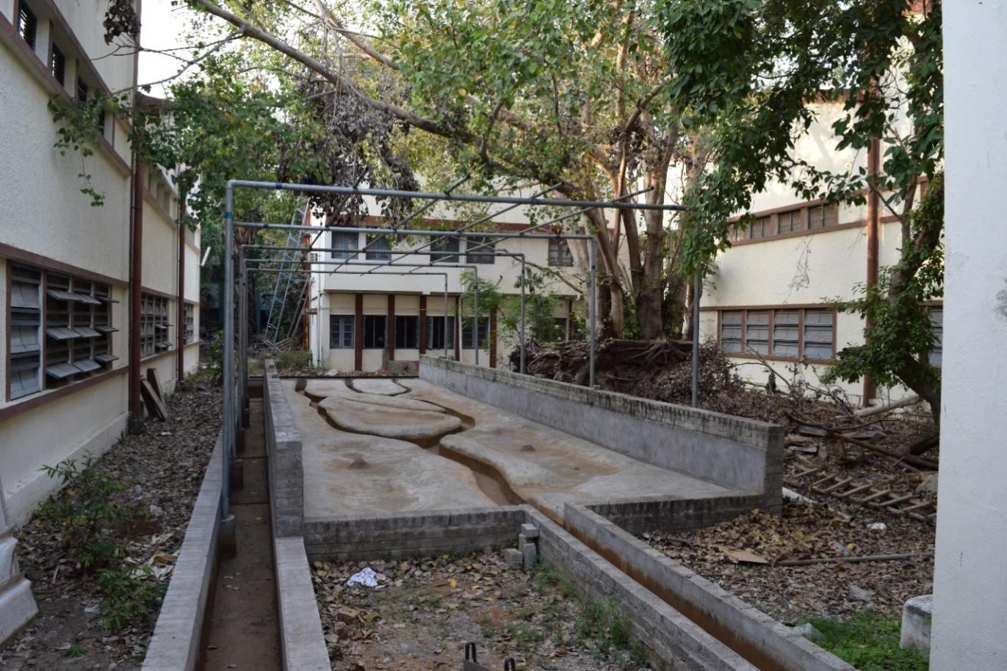
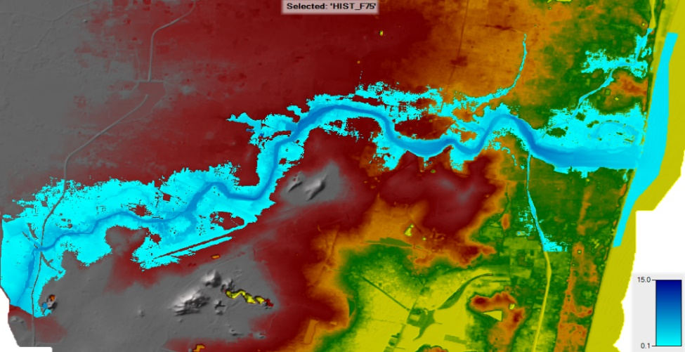
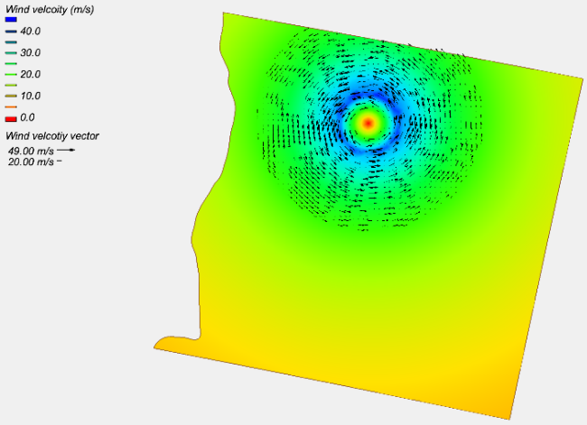
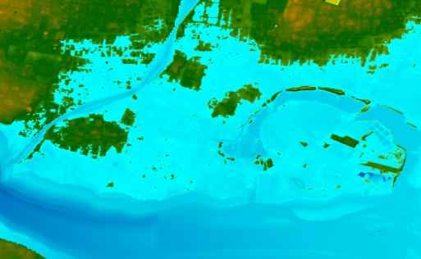
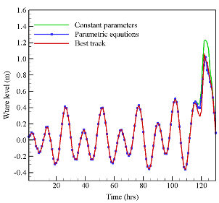
Dr. Somendra Nath Kuiry
Ph.D., IIT Kharagpur
Assistant Professor, Dept. of Civil Engineering
044 -2257 4309; snkuiry@iitm.ac.in
http://www.civil.iitm.ac.in/kuiry_edu
Computational Hydraulics – river, coastal and dam-break flow, urban flood, flash flood
Experimental Hydraulics – flow and sediment transport in river-networks
Ocean Dynamics - storm surge and tsunami wave propagation, interaction of river and ocean

Slide 6
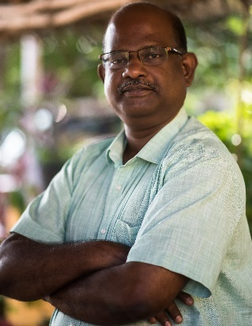
Dr. K. P. Sudheer
Ph.D, IIT Delhi, India
Professor, Dept. of Civil Engineering
044-2257-4288; sudheer@iitm.ac.in
http://www.civil.iitm.ac.in/sudheer_edu
Hydrologic Modeling
Predictions in Ungauged Basins (PUB)
Uncertainty and Sensitivity Analysis
Distributed Hydrological Models for PUB
Hydrologic Prediction Band
Construction of Prediction band
Employing Distributed Hydrological Models for Water Resources Assessment

Slide 7
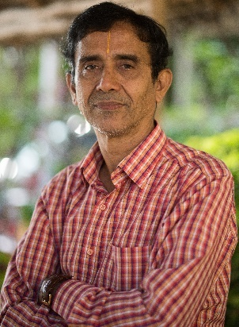
Dr. K. Srinivasan
Ph.D, IIT Madras
Professor, Dept. of Civil Engineering
044-2257-4269; ksrini@iitm.ac.in
www.civil.iitm.ac.in/srini_edu
Water Resources Planning and Management
Flood Management
Regionalization of Hydrologic Information.
Stochastic Modeling of Hydrologic Processes
Optimal Design and Rehabilitation of Water Distribution Systems

Slide 8
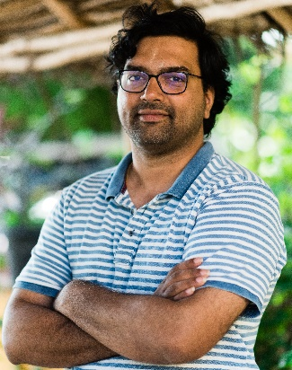

Dr. Venkatraman Srinivasan
PhD, University of Illinois Urbana Champaign, USA
Assistant Professor, Civil Engineering
phone: 044-2257-4321; email: venkatraman@iitm.ac.in
website: http://www.home.iitm.ac.in/venkatraman
Major Areas of Research
Process based eco-hydrological models of vegetated land surfaces
Climate change impact on food and water security
Experimental manipulation of crop micro climate environment
Develop an experimental greenhouse facility to study plant behavior under various microclimatic conditions
Develop a high resolution 3D explicit architecture plant canopy and root system ecohydrological model
Predict impact of climate change on future food and water security and suggest mitigation measures
Predict the response of vegetation under abiotic stresses and climate change

Slide 9
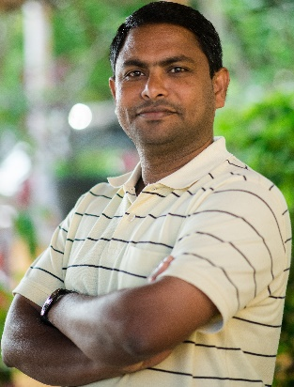
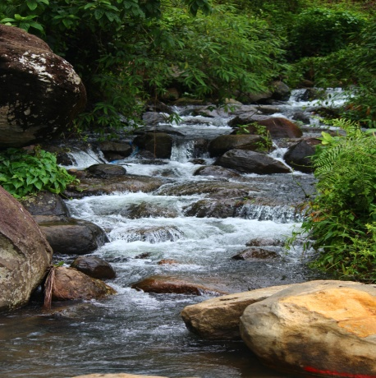
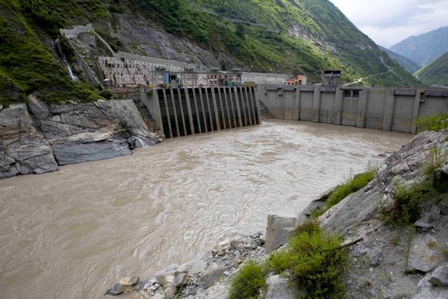
Dr. Venu Chandra
Ph.D., IIT Kanpur
Associate Professor, Dept. of Civil Engineering
044 -2257 4281; vc@iitm.ac.in
Experimental Hydraulics
Sediment Transport
Cohesive Sediment Dynamics
River Training and Scour Protection Works
Step pool hydrodynamics in mountain streams
Annular flume
(Cohesive sediment studies)
Field application
Laboratory to field to prevent sedimentation at hydraulic structures

Slide 10
Dr. Chandan Sarangi
PhD (Indian Institute of Technology, Kanpur, India)
Assistant Professor, Civil Engineering
chandansarangi@iitm.ac.in
Major Areas of Research
Impact of aerosols (particulate air pollution) on hydrometeorological processes (clouds, rainfall, fog, transpiration)
Impact of dust deposition on Himalayan hydrology
Modelling fate and transport of aerosols at regional and global scale
Relative role of aerosols on temperature and extreme rainfall over Megacities
Aerosols and Hydro-Meteorology (ahm) Lab

Slide 11
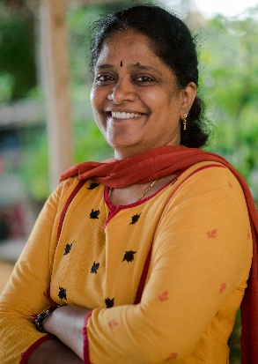
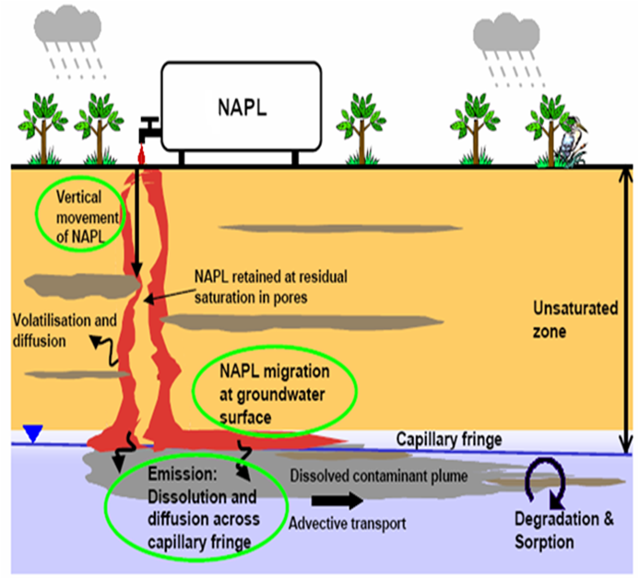
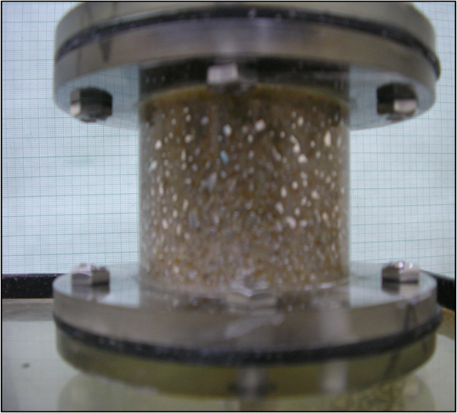
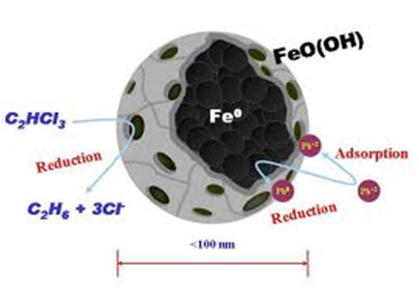
Dr. Indumathi M Nambi
Ph.D, Clarkson University, U.S.A
Professor, Dept. of Civil Engineering
044-2257-4289; indunambi@iitm.ac.in
http://www.iitm.ac.in/indu_edu
Ground Water Contamination including NAPL /Transport and Remediation
Industrial Wastewater Treatment/Physical and Chemical Processes
Water and Waste Water /Tertiary treatment for reuse
Mercury entrapped in soil
Nano Iron
Experimental Studies span from pore scale to lab scale and field scale

Slide 12
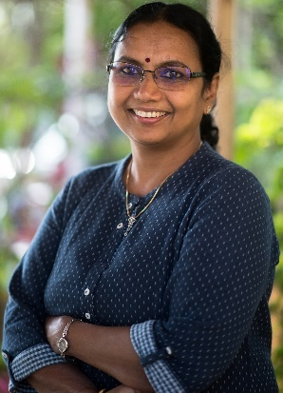
Dr. Ligy PhiliP
Ph.D, IIT Kanpur, India
Professor, Dept. of Civil Engineering
044-2257-4274; ligy@iitm.ac.in
http://www.civil.iitm.ac.in/ligy_edu
Bioremediation of Contaminated Water, Soils, Air and Aquifers
Water Treatment and Rural Water Supply
Domestic and Industrial Wastewater Treatment, Recycle and Reuse
To cleanup soils , aquifers and air contaminated with organic and inorganic toxic pollutants
Water quality assessment and providing tailor made centralized and point of use water treatment technologies
Sustainable Wastewater management using centralized/decentralized and onsite systems
Pollution Abatement, Drinking water quality assessment and treatment

Slide 13
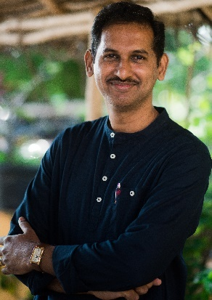
Dr. S. Mathava Kumar
Associate Professor, Civil Engineering
044-2257-4267; mathav@iitm.ac.in
http://www.civil.iitm.ac.in/mathav_edu
Major Areas of Research
Membrane Technology for Water and Wastewater Treatment
Emerging Contaminants/Micro-Pollutants Removal
Development of Low-cost adsorbents & Remediation of Contaminated Systems
Technology for Emerging Contaminants/Micro-Pollutants Removal
Membrane (Bio)reactor for wastewater treatment
Solid Waste Management and Leachate Treatment
Application of technologies for water, wastewater and solid waste management

Slide 14

Dr. S. Mohan
Ph.D, Indian Institute of Science, Bangalore
Professor, Dept. of Civil Engineering
044-2257-4261; smohan@iitm.ac.in
http://www.civil.iitm.ac.in/mohan_edu
Environmental systems analysis & modeling,
Environmental impact analysis,
Reservoir operation,
Contaminant transport modeling,
Sustainable development, GIS & applications,
Evolutionary algorithms & their applications
Evolutionary Algorithms
Sustainable Development
Water, Air, and Land Pollution Abatement
EARTH ALLOWS YOU TO STAND; LET IT STAND THE WAY IT IS

Slide 15
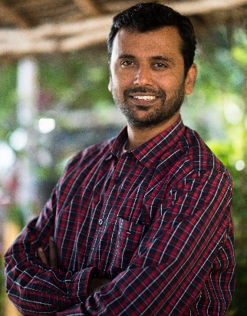
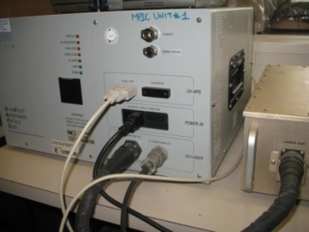
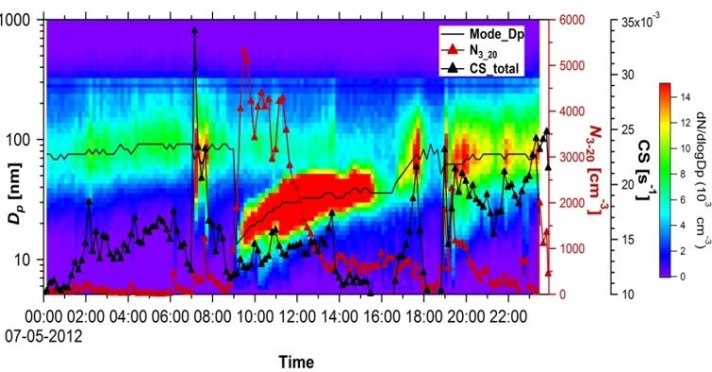
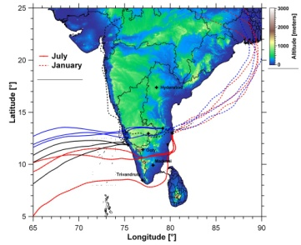
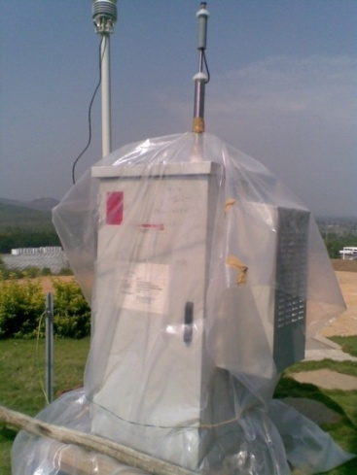
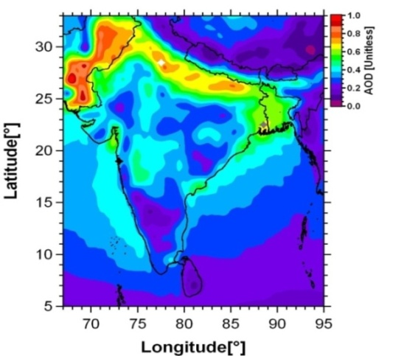
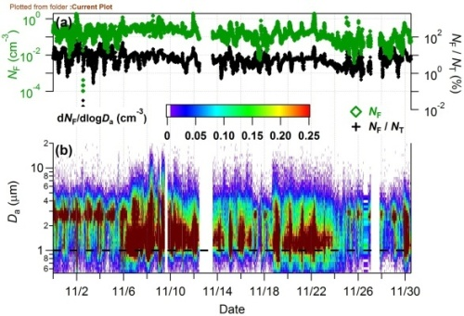
Dr. Sachin S. Gunthe
Ph.D, Indian Institute of Tropical Meteorology, India
Associate Professor, Dept. of Civil Engineering
044-2257-4308; s.gunthe@iitm.ac.in
http://www.civil.iitm.ac.in/gunthe_edu
Properties and interaction of atmospheric aerosols including bioaerosols
Role of atmospheric aerosols in Earth system science
Aerosol cloud precipitation interaction – Indian monsoon
Field campaigns
Laboratory studies
Numerical simulations

Slide 16
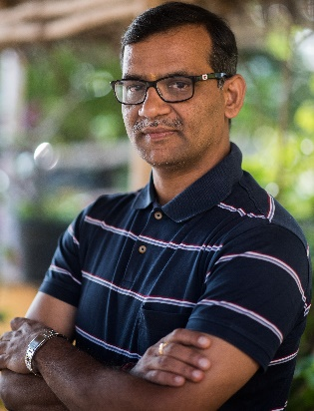
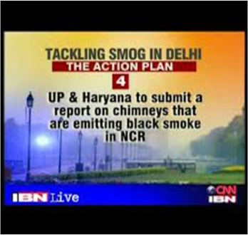
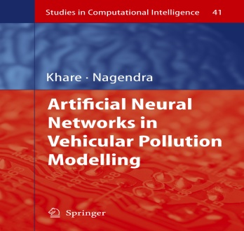
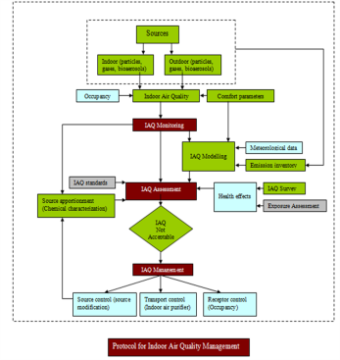
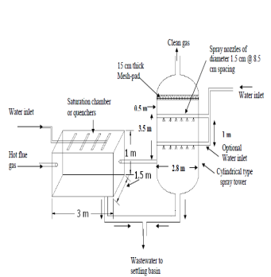
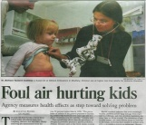
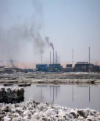
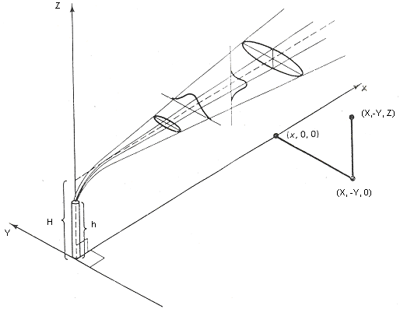
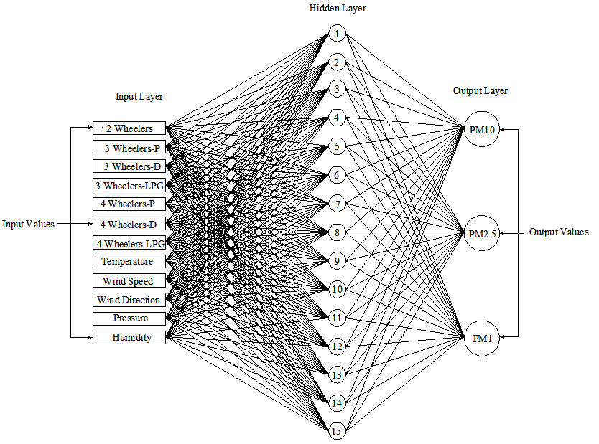
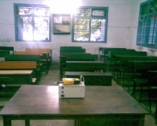
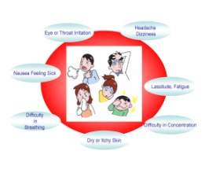
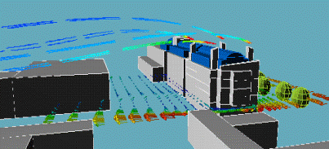
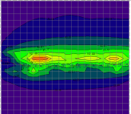

Dr. S.M. Shiva Nagendra
Ph.D., IIT Delhi, India
Professor, Department of Civil Engineering
044-2257-4290; snagendra@iitm.ac.in
http://www.civil.iitm.ac.in/shiva_edu/
RESEARCH INTERESTS
Urban Air Quality Management | Emission inventory, air quality monitoring, modelling , source-receptor modelling and control strategies
Vehicular Pollution Modelling | Deterministic, statistical and artificial neural network approaches
Indoor Air Quality | Monitoring, modelling and control strategies
Industrial Air Pollution Control | Design of air pollution control equipments and environmental impact assessment
Environmental data analysis | Multivariate data analysis and environmental auditing
Scrubber
Environmental Pollution Index
Stack Emissions Modelling
Indoor Air
Quality Management
Urban Air Quality Management
Industrial Pollution Control

