Slide 1
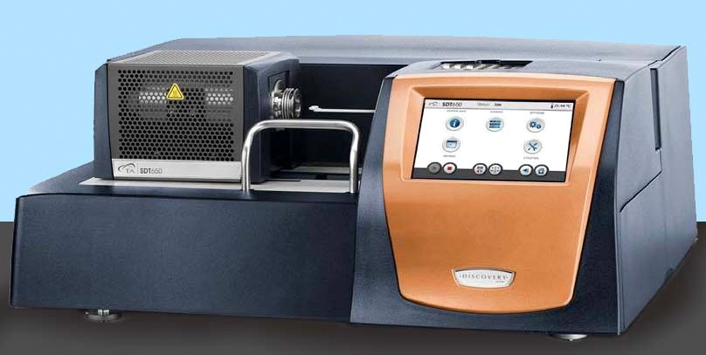
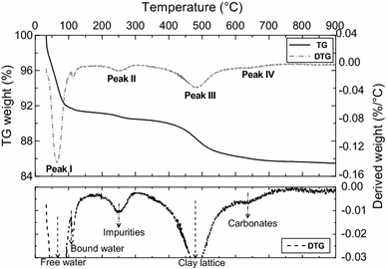
Thermogravimetric Analyzer
Working Principle
TGA measures a sample's weight as it is heated or cooled in a furnace
TGA
Application
To determine the composition and decomposition behavior of complex materials, thermal stability analysis
TGA and DTG graph for sodium bentonite

Slide 2
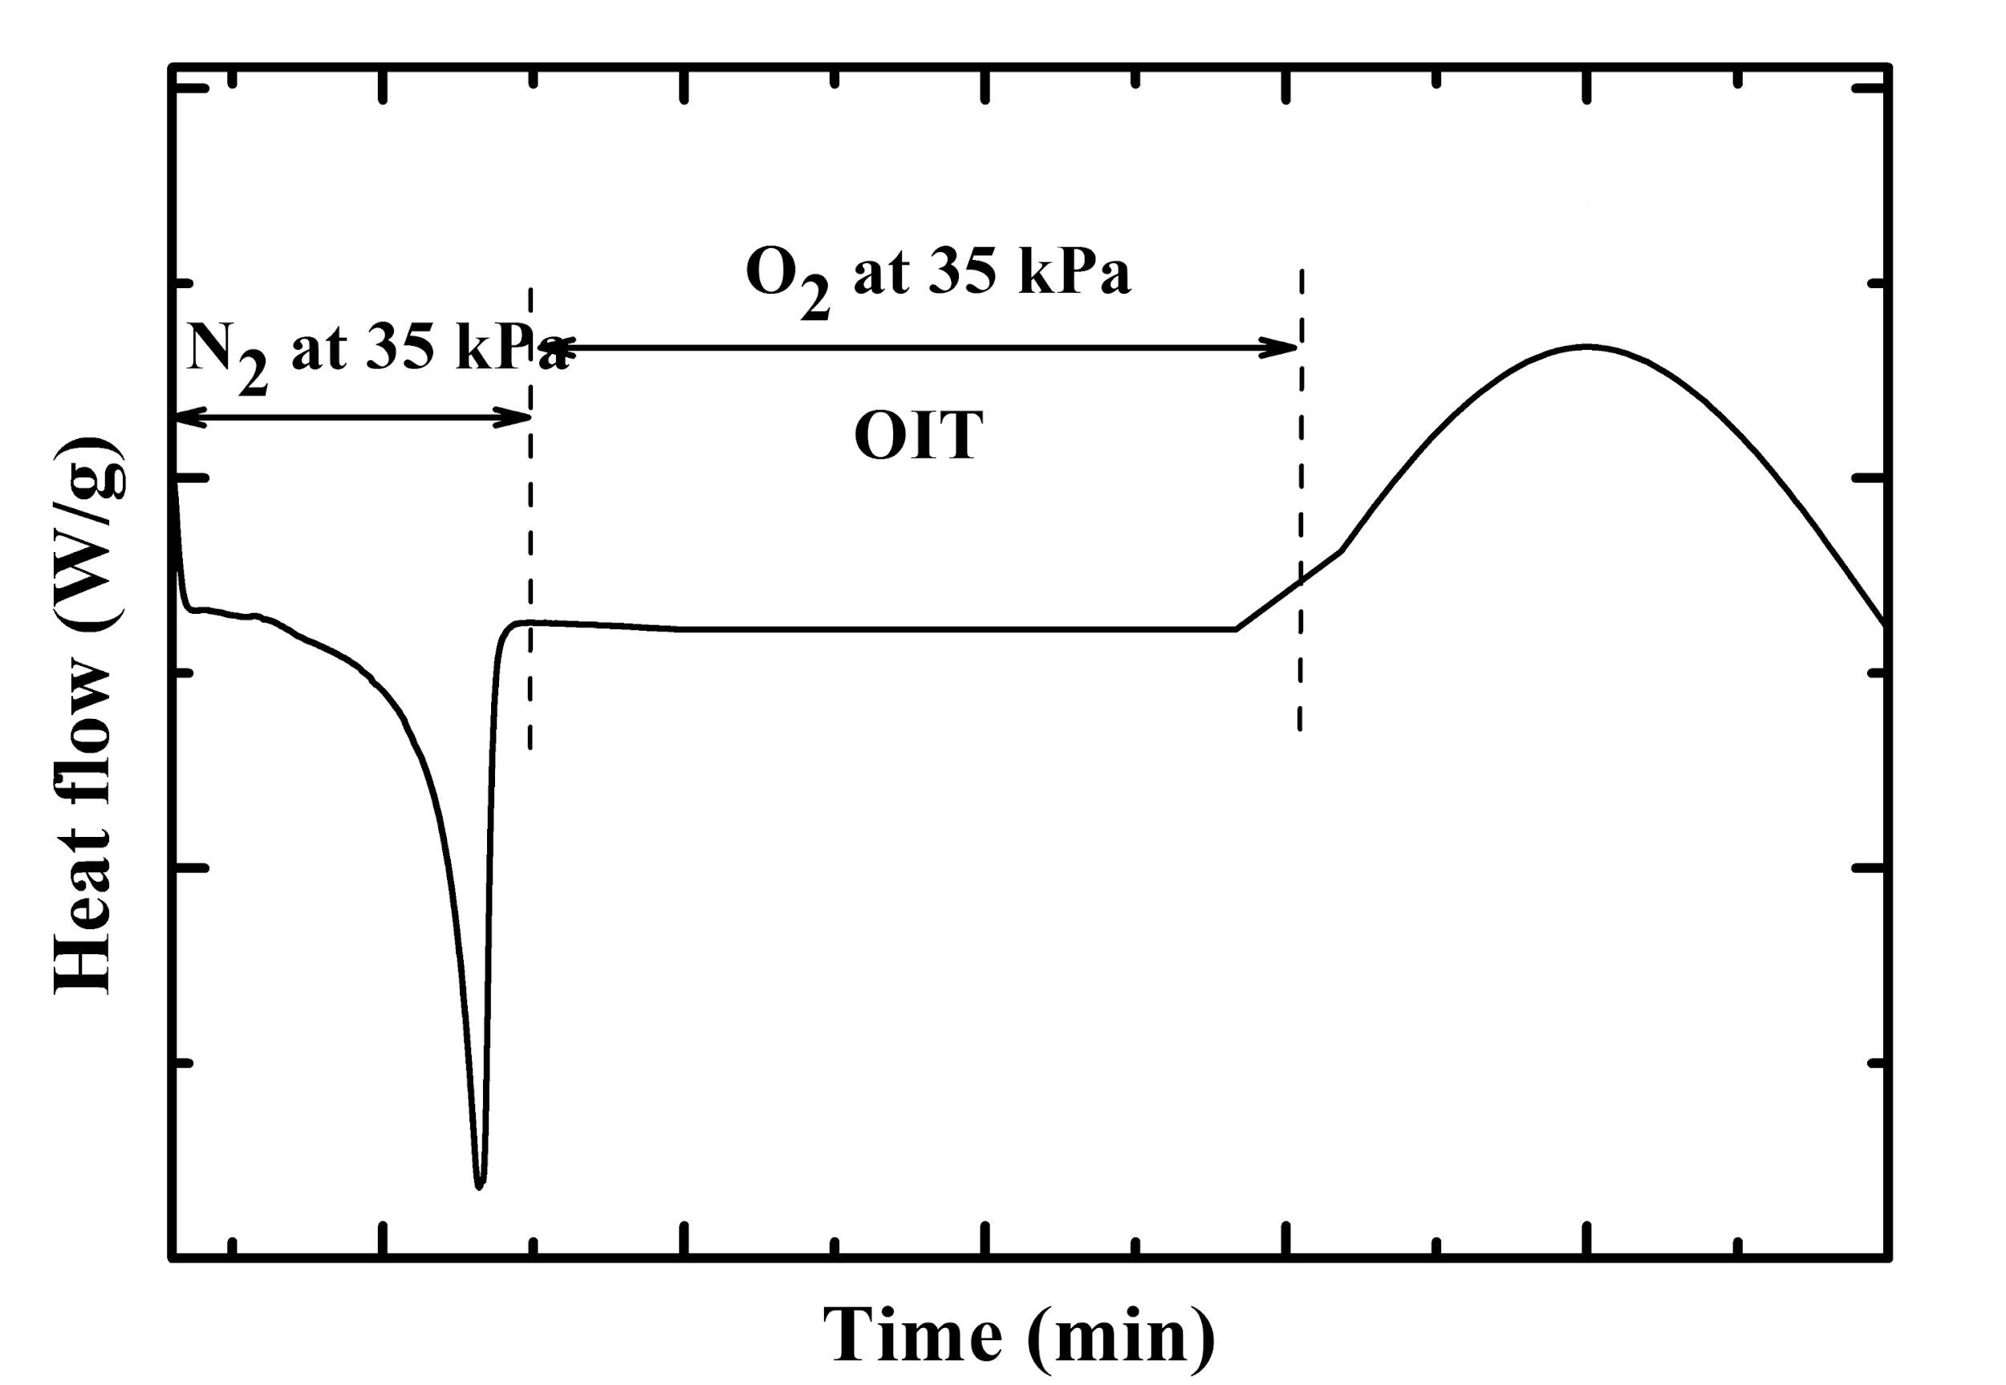
Differential Scanning Calorimeter
Working Principle
Measures enthalpy change of sample as a function of temperature
Application
DSC Instrument
Used to identify polymer and its properties
Determination of thermodynamic and thermophysical properties
OIT response of HDPE

Slide 3
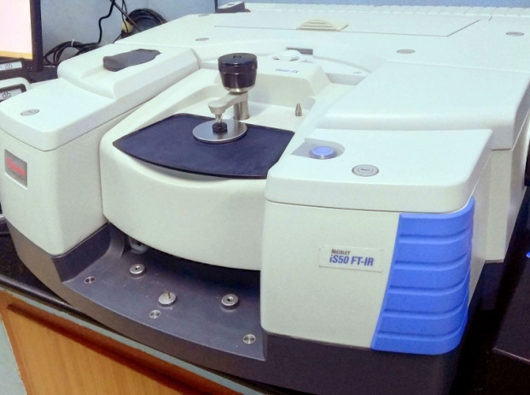
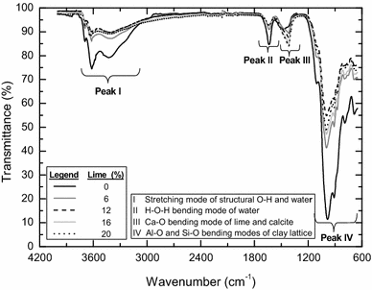
Fourier Transform Infrared Spectrometer
Working Principle
The chemical bonds present in the material absorbs the infrared radiation at corresponding wavelength.
Application
FTIR instrument
To qualitatively determine chemical composition of materials
Forensic analysis, quality control and assurance.
FTIR spectra of lime stabilised soils

Slide 4
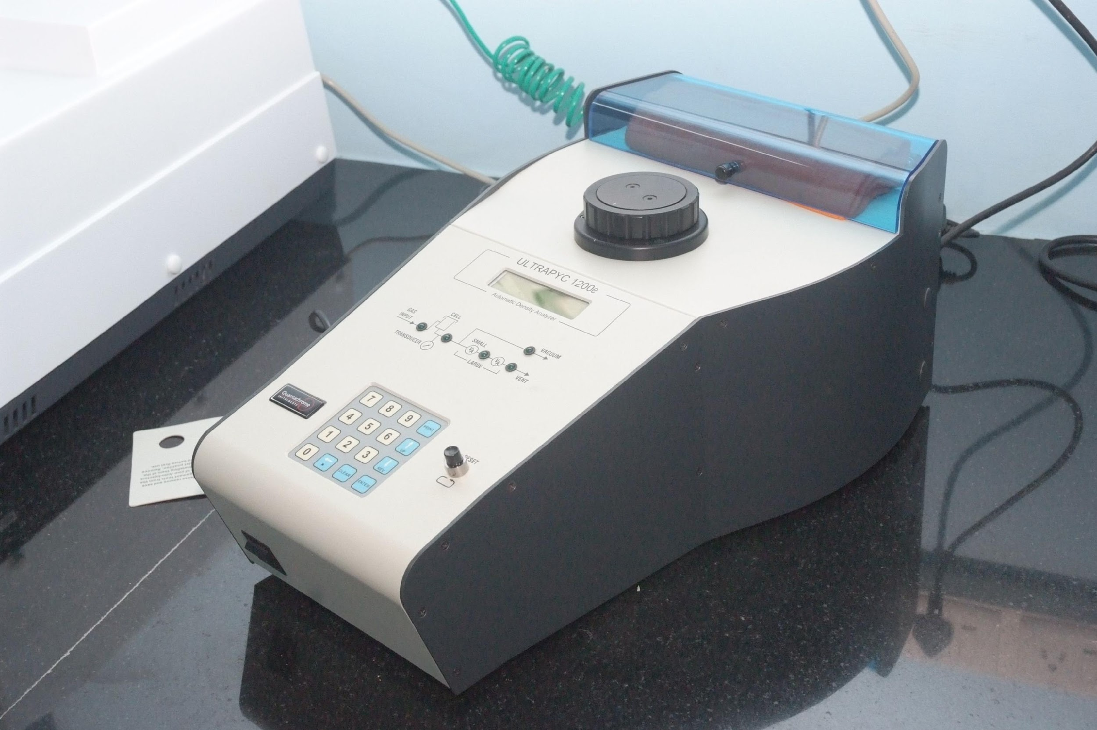
Helium Gas Pycnometer
Working Principle
Solid volume is measured by employing gas displacement as per Boyle’s law.
Helium gas pycnometer
Application
To accurately measure the volume of solids and true density.

Slide 5
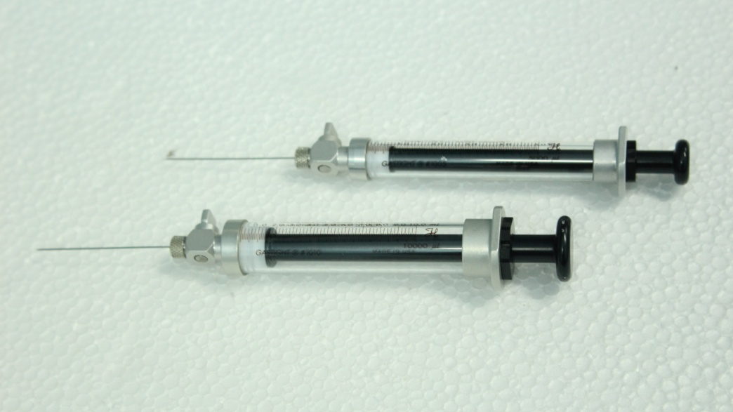
Gas Chromatography
Working Principle
In gas chromatography (GC), the mobile phase is a carrier gas. The stationary phase is a polymer on an inert solid support. The gaseous compounds being analyzed interact with the walls of the column, which is coated with a stationary phase. This causes each compound to elute at a different time, known as the retention time of the compound.
Agilent gas chromatograph (GC) 7890A
Application
GC is used for qualitative and quantitative analysis of compounds that can be vaporized without decomposition.
Gas tight syringe for gas injection

Slide 6
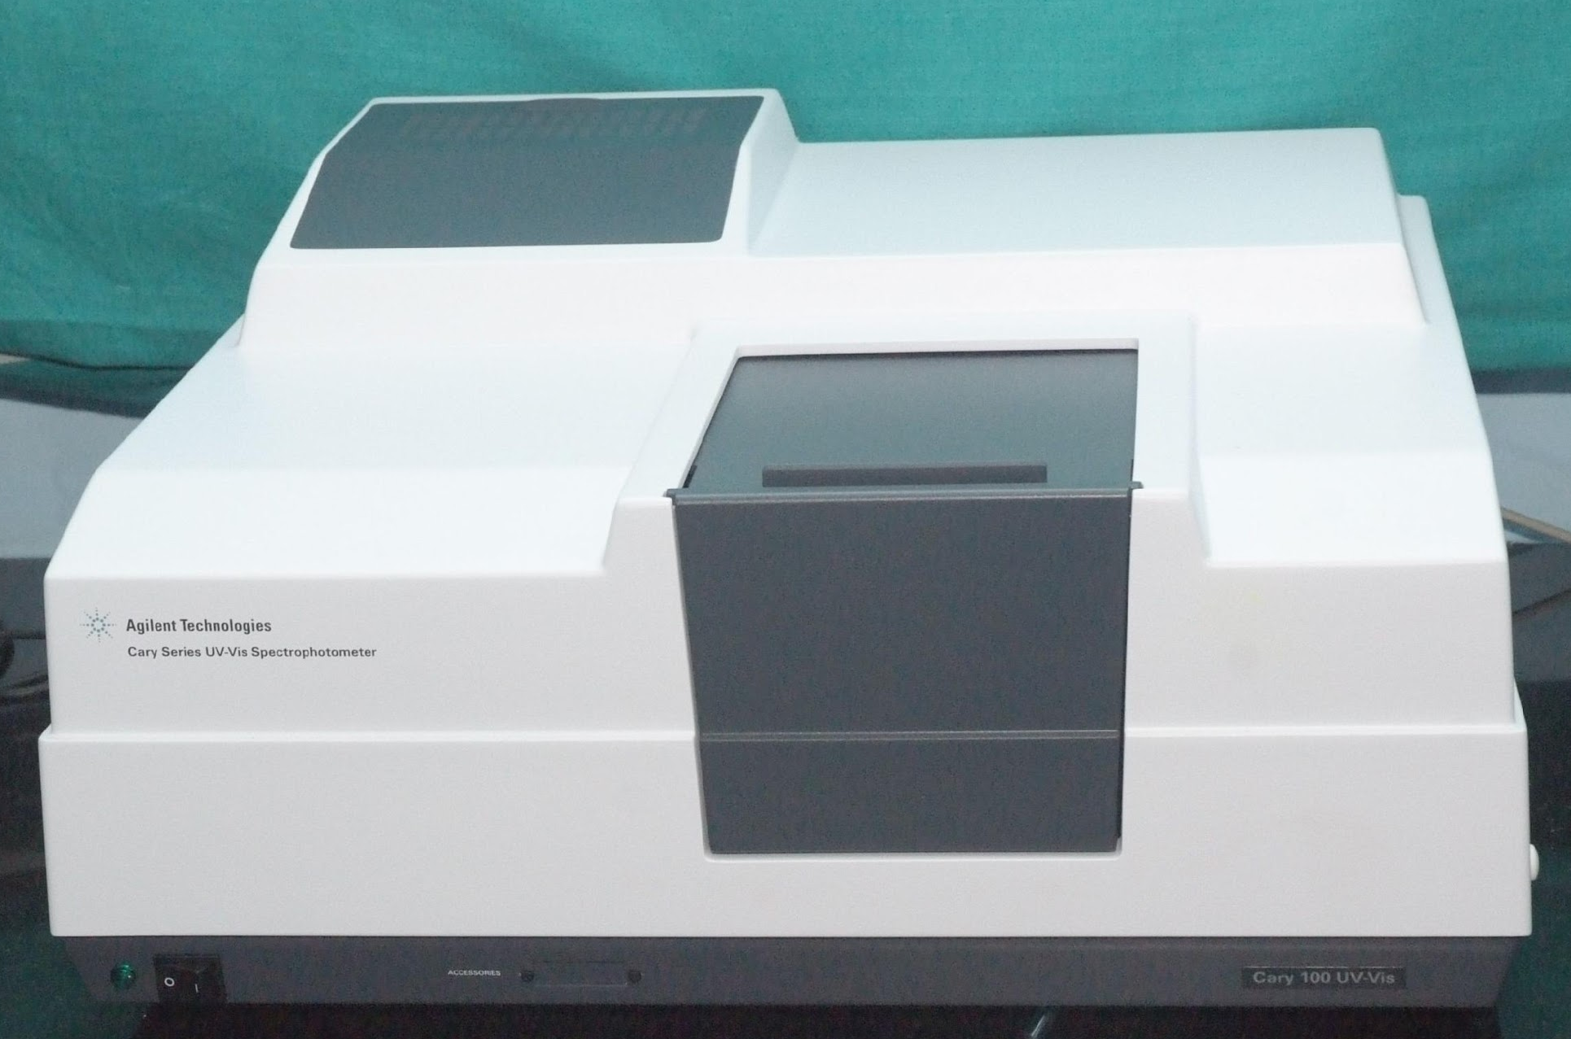
UV Visible Spectrophotometer
Working Principle
The absorption of ultraviolet light or visible light by chemical compounds results in the production of a distinct spectra.
UV-Visible spectrophotometer
Application
Quantification of specific substances and aggregate parameters in water and wastewater, quantitative determination of transition metal ions, organic compounds, and biological macromolecules

Slide 7
Atomic Absorption Spectrometer
Working Principle
AAS measures the concentration of elements in a liquid sample based on energy absorbed from certain wavelengths of light
Application
AAS instrument
To quantify the elements in a solution.
To detect trace amounts of harmful chemicals in water samples

Slide 8
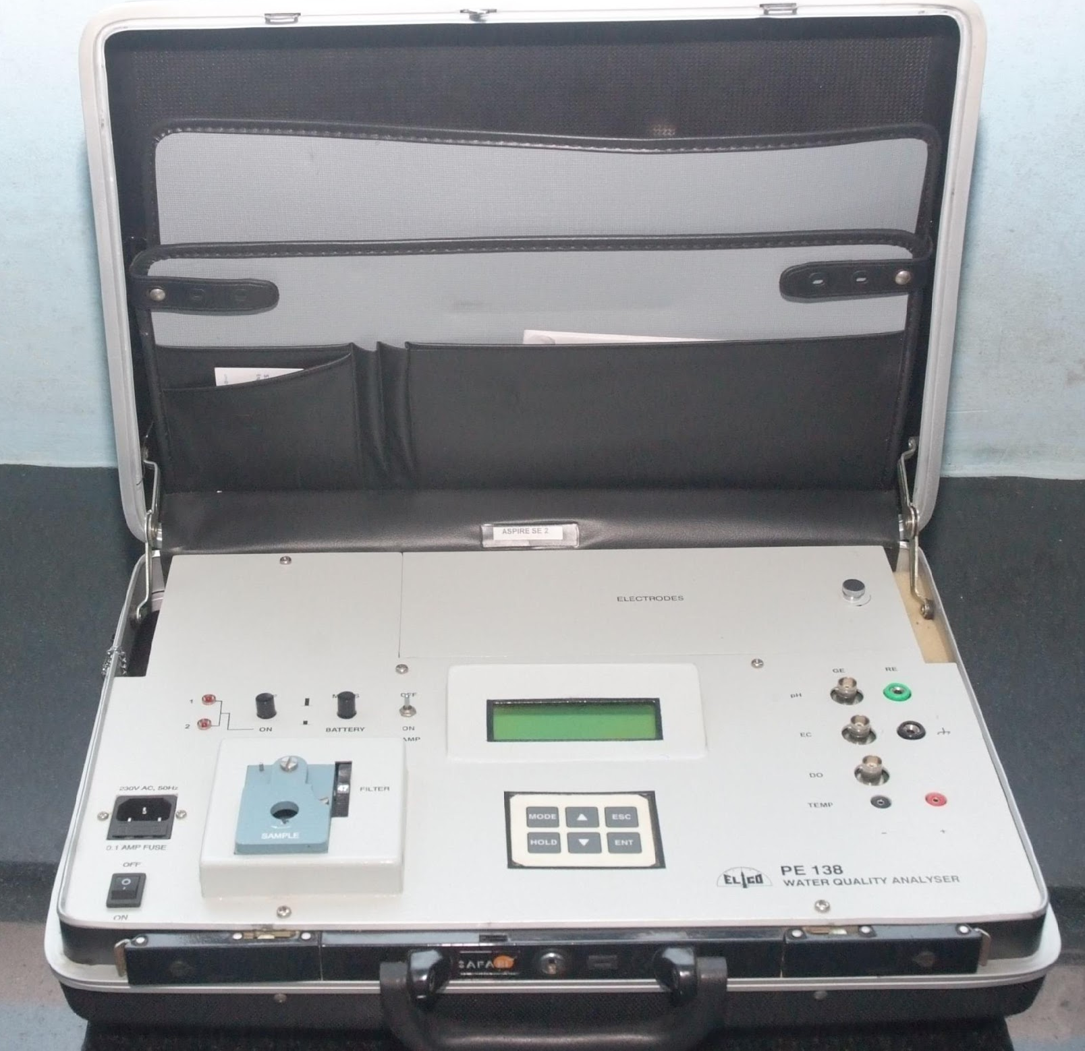
Water Quality Analyzer
Working Principle
Water quality standards are measured using an electrode after suitable calibration with the standards
Application
Measurement of pH, electrical conductivity and total dissolved solids
Water Quality Analyzer

Slide 9
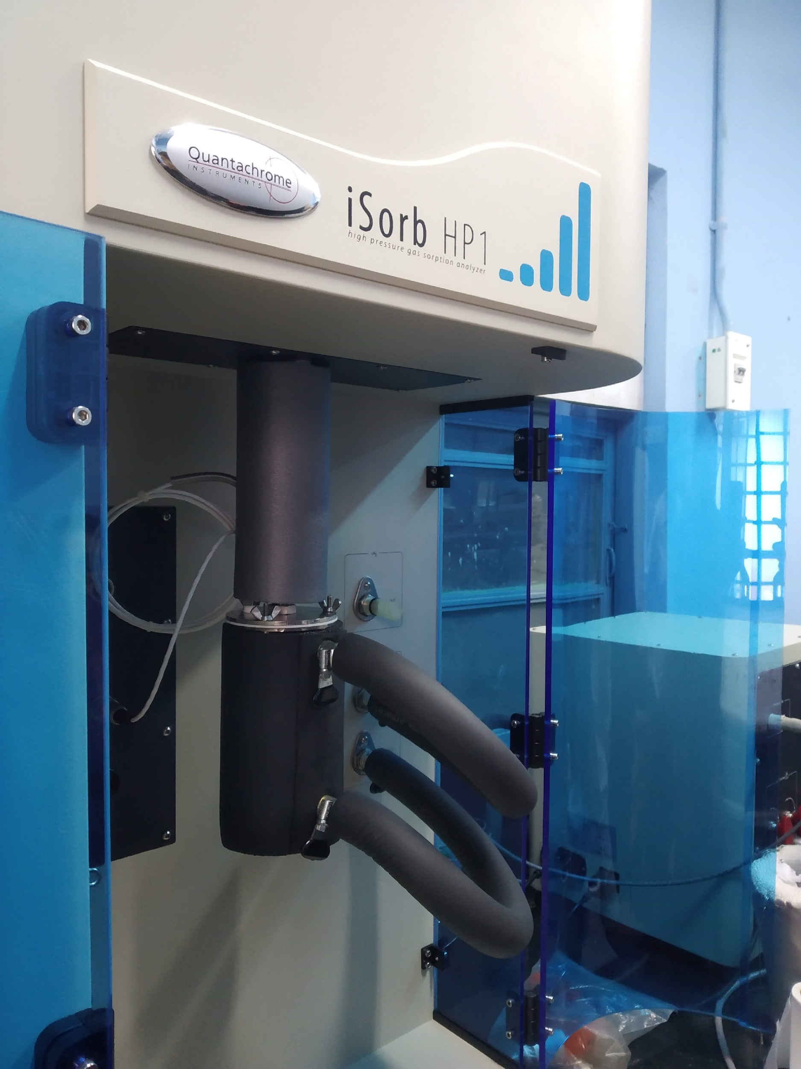
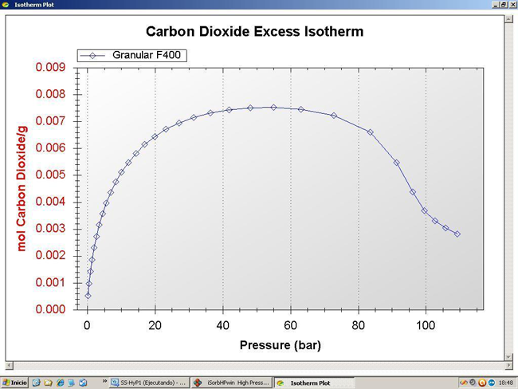
iSorb-HP
Working Principle
A known amount of gas is allowed to expand into a sealed container with sorbent. The amount of gas adsorbed can be calculated from the mass balance equation, provided the void volume of sorbent is known.
Application
iSorb-HP
To determine the adsorption-desorption isotherms and kinetics for gases over a wide range of pressures (upto 200 bar) and temperatures(upto 400°C).
CO₂ adsorption isotherm on F400

Slide 10
AutoSorb
Working Principle
Extended- range opore size and surface area analysis using appropriate adsorbate is made by high vacuum, oil free turbomolecular system and high precision low pressure transducers
Application
BET surface area, TPD, TPR.
Representative Image of AutoSorb Equipment, Yet to Install)

Slide 11
Accelerated UV Weatherometer
Working Principle
Simulates field exposure conditions in a landfill using fluorescent UV and condensation weathering methods
Application
To study the longevity of geomembranes subjected to accelerated UV ageing
UV weatherometer

Slide 12
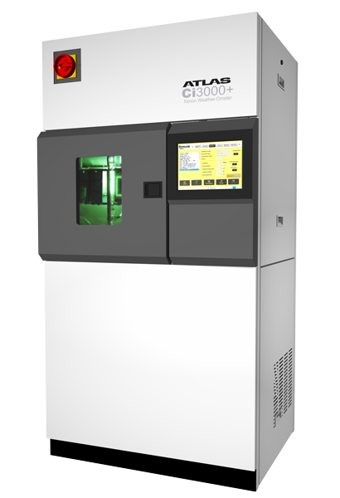
Accelerated Xenon Arc Weatherometer
Working Principle
Simulates field weathering conditions using xenon arc lamps and condensation techniques
Application
To study the longevity of geomembranes subjected to accelerated UV ageing
Xenon Arc weatherometer

Slide 13
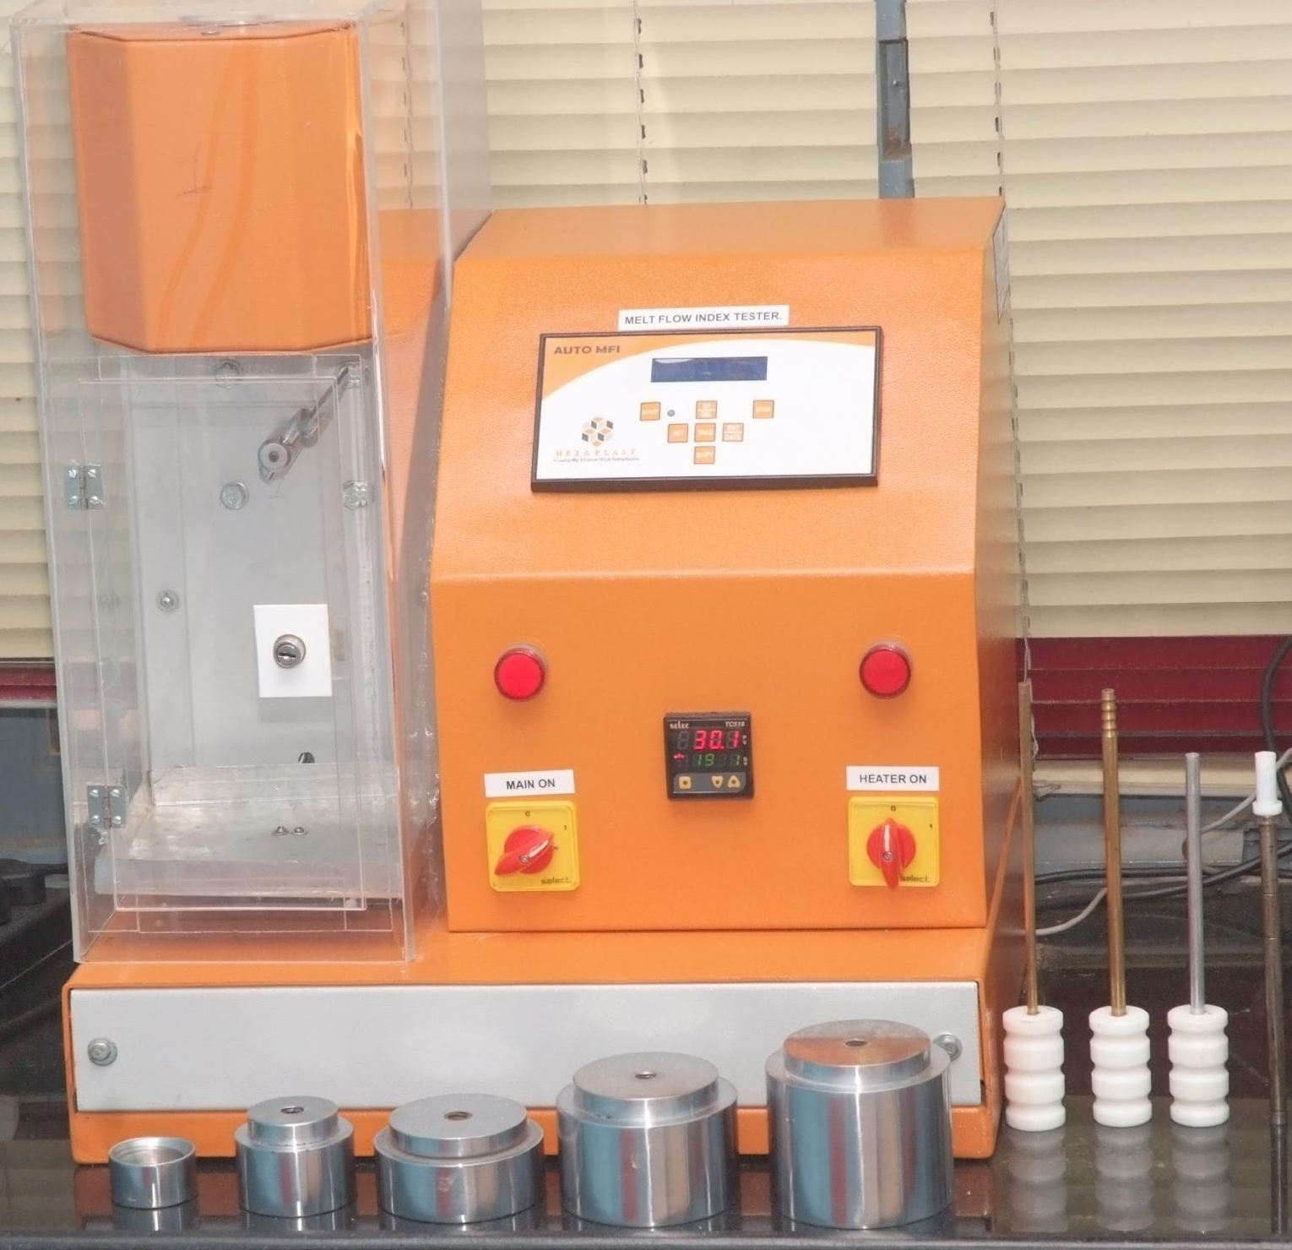
Melt Flow Index
Working Principle
Measures the rate of extrusion of molten polymer at specified conditions
Application
Indicative of molecular weight, quality control
Melt Flow Index

Slide 14
Geomembrane Dog Bone Cutter
Working Principle
To cut the geomembrane into a dog bone shaped sample
Application
To assess the tensile strength, crack resistance of geomembranes
Dog Bone cutter

Slide 15
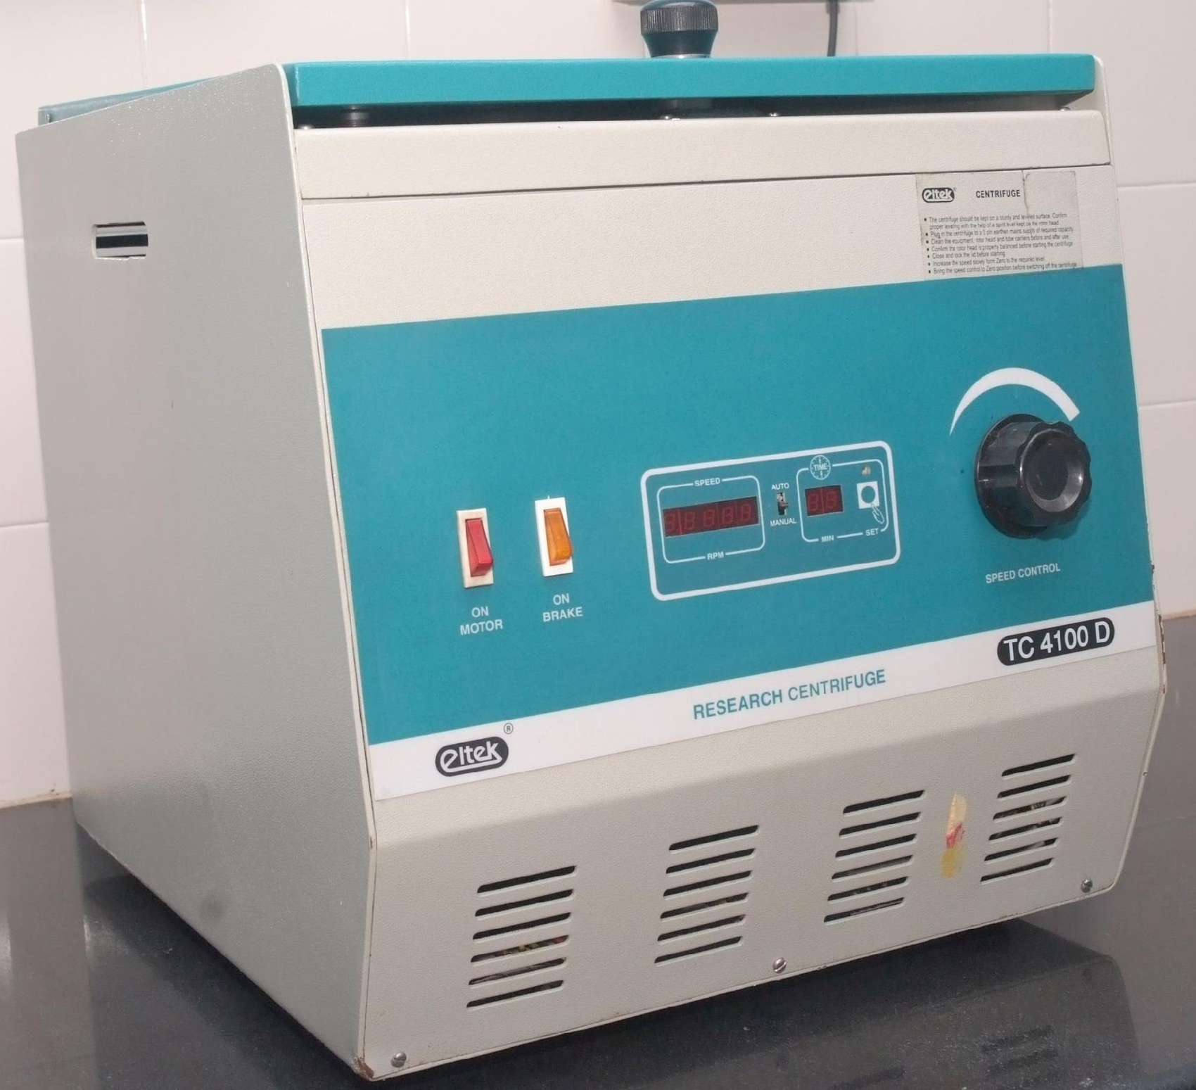
Research Centrifuge
Working Principle
The radial acceleration causes denser particles to settle to the bottom of the tube, while low-density substances rise to the top
Application
Separation of mixtures with close densities,separate immiscible liquids, suspended solids and insoluble particles
Research Centrifuge

Slide 16
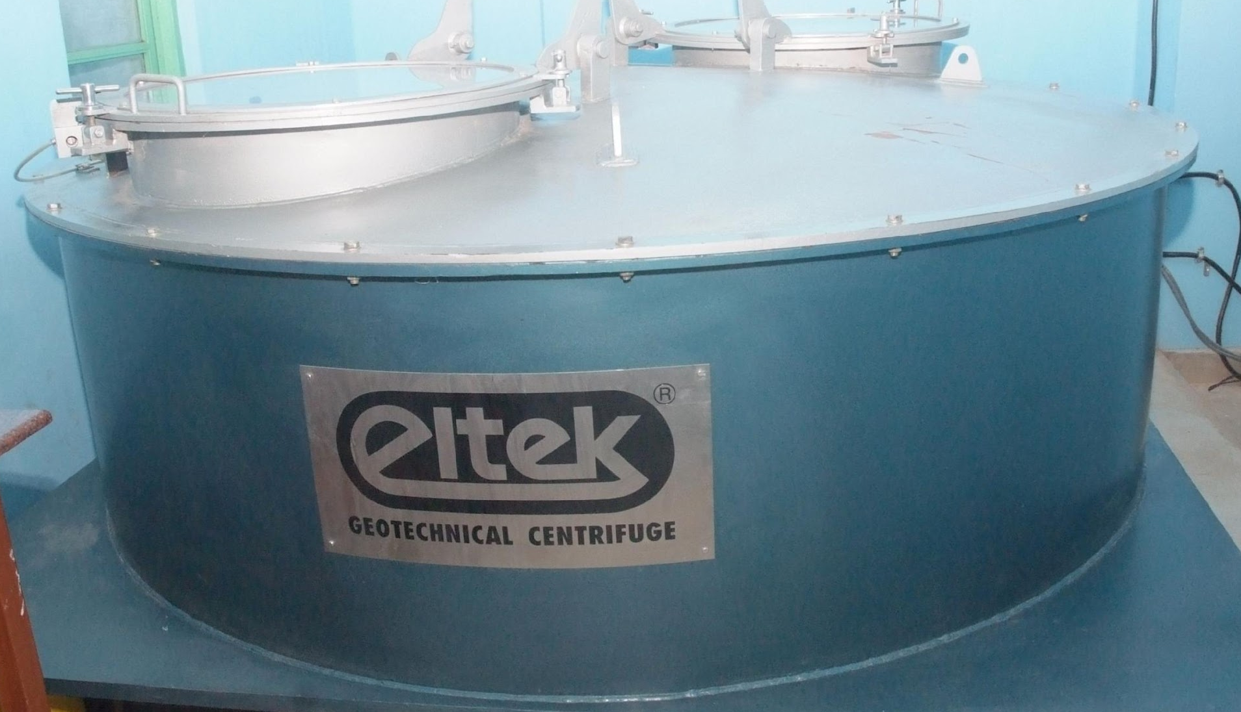
Geotechnical Centrifuge
Working Principle
Centrifugal acceleration to simulate increased gravitational acceleration
Application
Geotechnical centrifuge
Used for testing physical scale models of geotechnical engineering systems

Slide 17
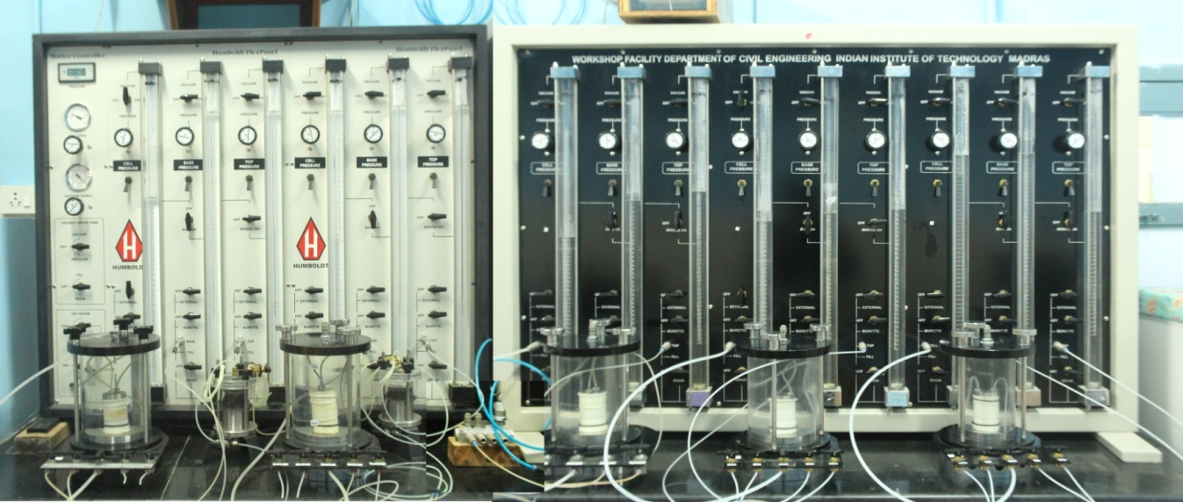
Flexible-wall Permeameter
Working Principle
Controls the effective stress conditions and degree of saturation by back-pressure application, and prevention of side-wall leakage during permeation via use of a latex membrane in close contact with the specimen
Application
Flexible wall permeameter
Measurement of hydraulic conductivity of saturated porous material

Slide 18
Sieve Shaker
Working Principle
A sieve shaker separates particles by passing them through a sieves and agitating the sample in order to obtain complete separation.
Application
To assess the particle size distribution of granular materials
Sieve shaker

Slide 19
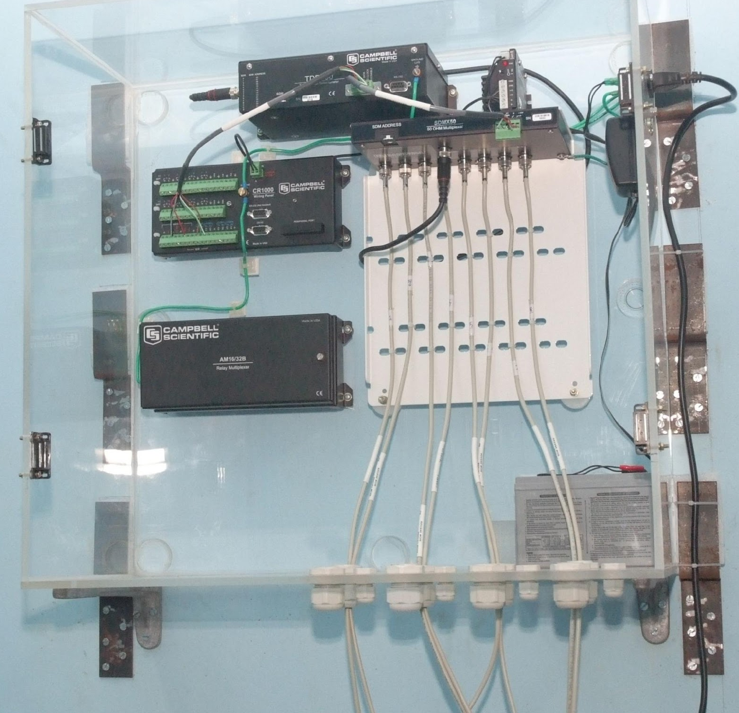
Time Domain Reflectometer
Working Principle
TDR sensors use parallel rods, acting as transmission lines. A voltage is applied to the rods and reflected back to the sensor for analysis. The speed or velocity of the voltage pulse along the rod is related to the apparent permittivity of the substrate
Application
Determination of soil moisture content, rate of infiltration.
Time domain deflectometer

Slide 20
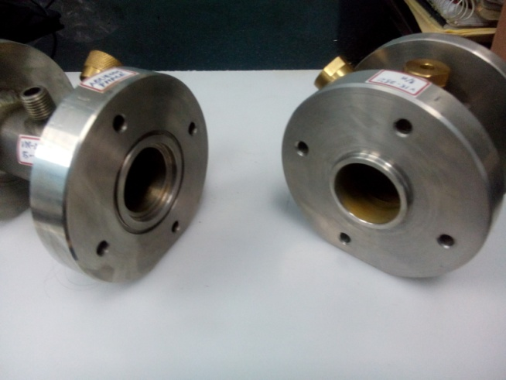
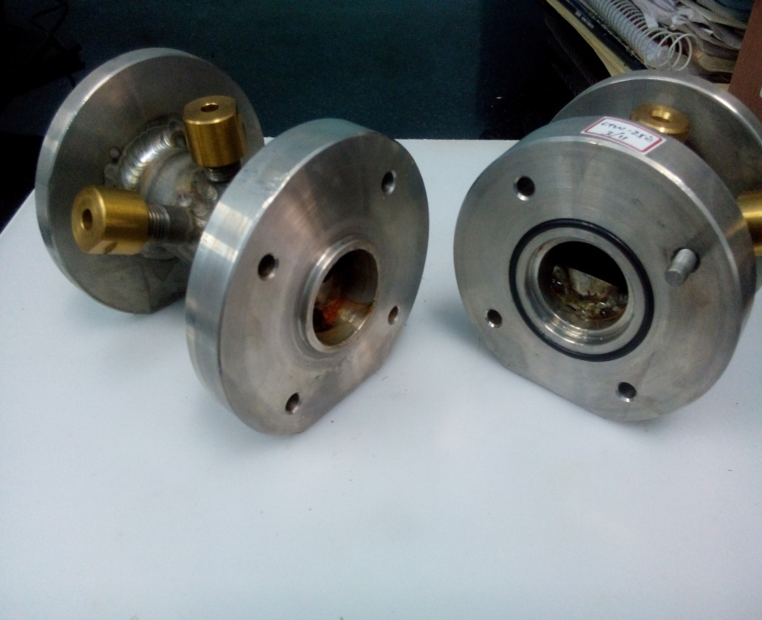
Fabricated Diffusion Cells
Working Principle
The concentration gradient between the source and receptor cell drives the contaminant by a process called diffusion
Application
Aqueous phase
Determination of diffusion coefficient of VOCs in both aqueous and vapor phase
Vapour phase

Slide 21
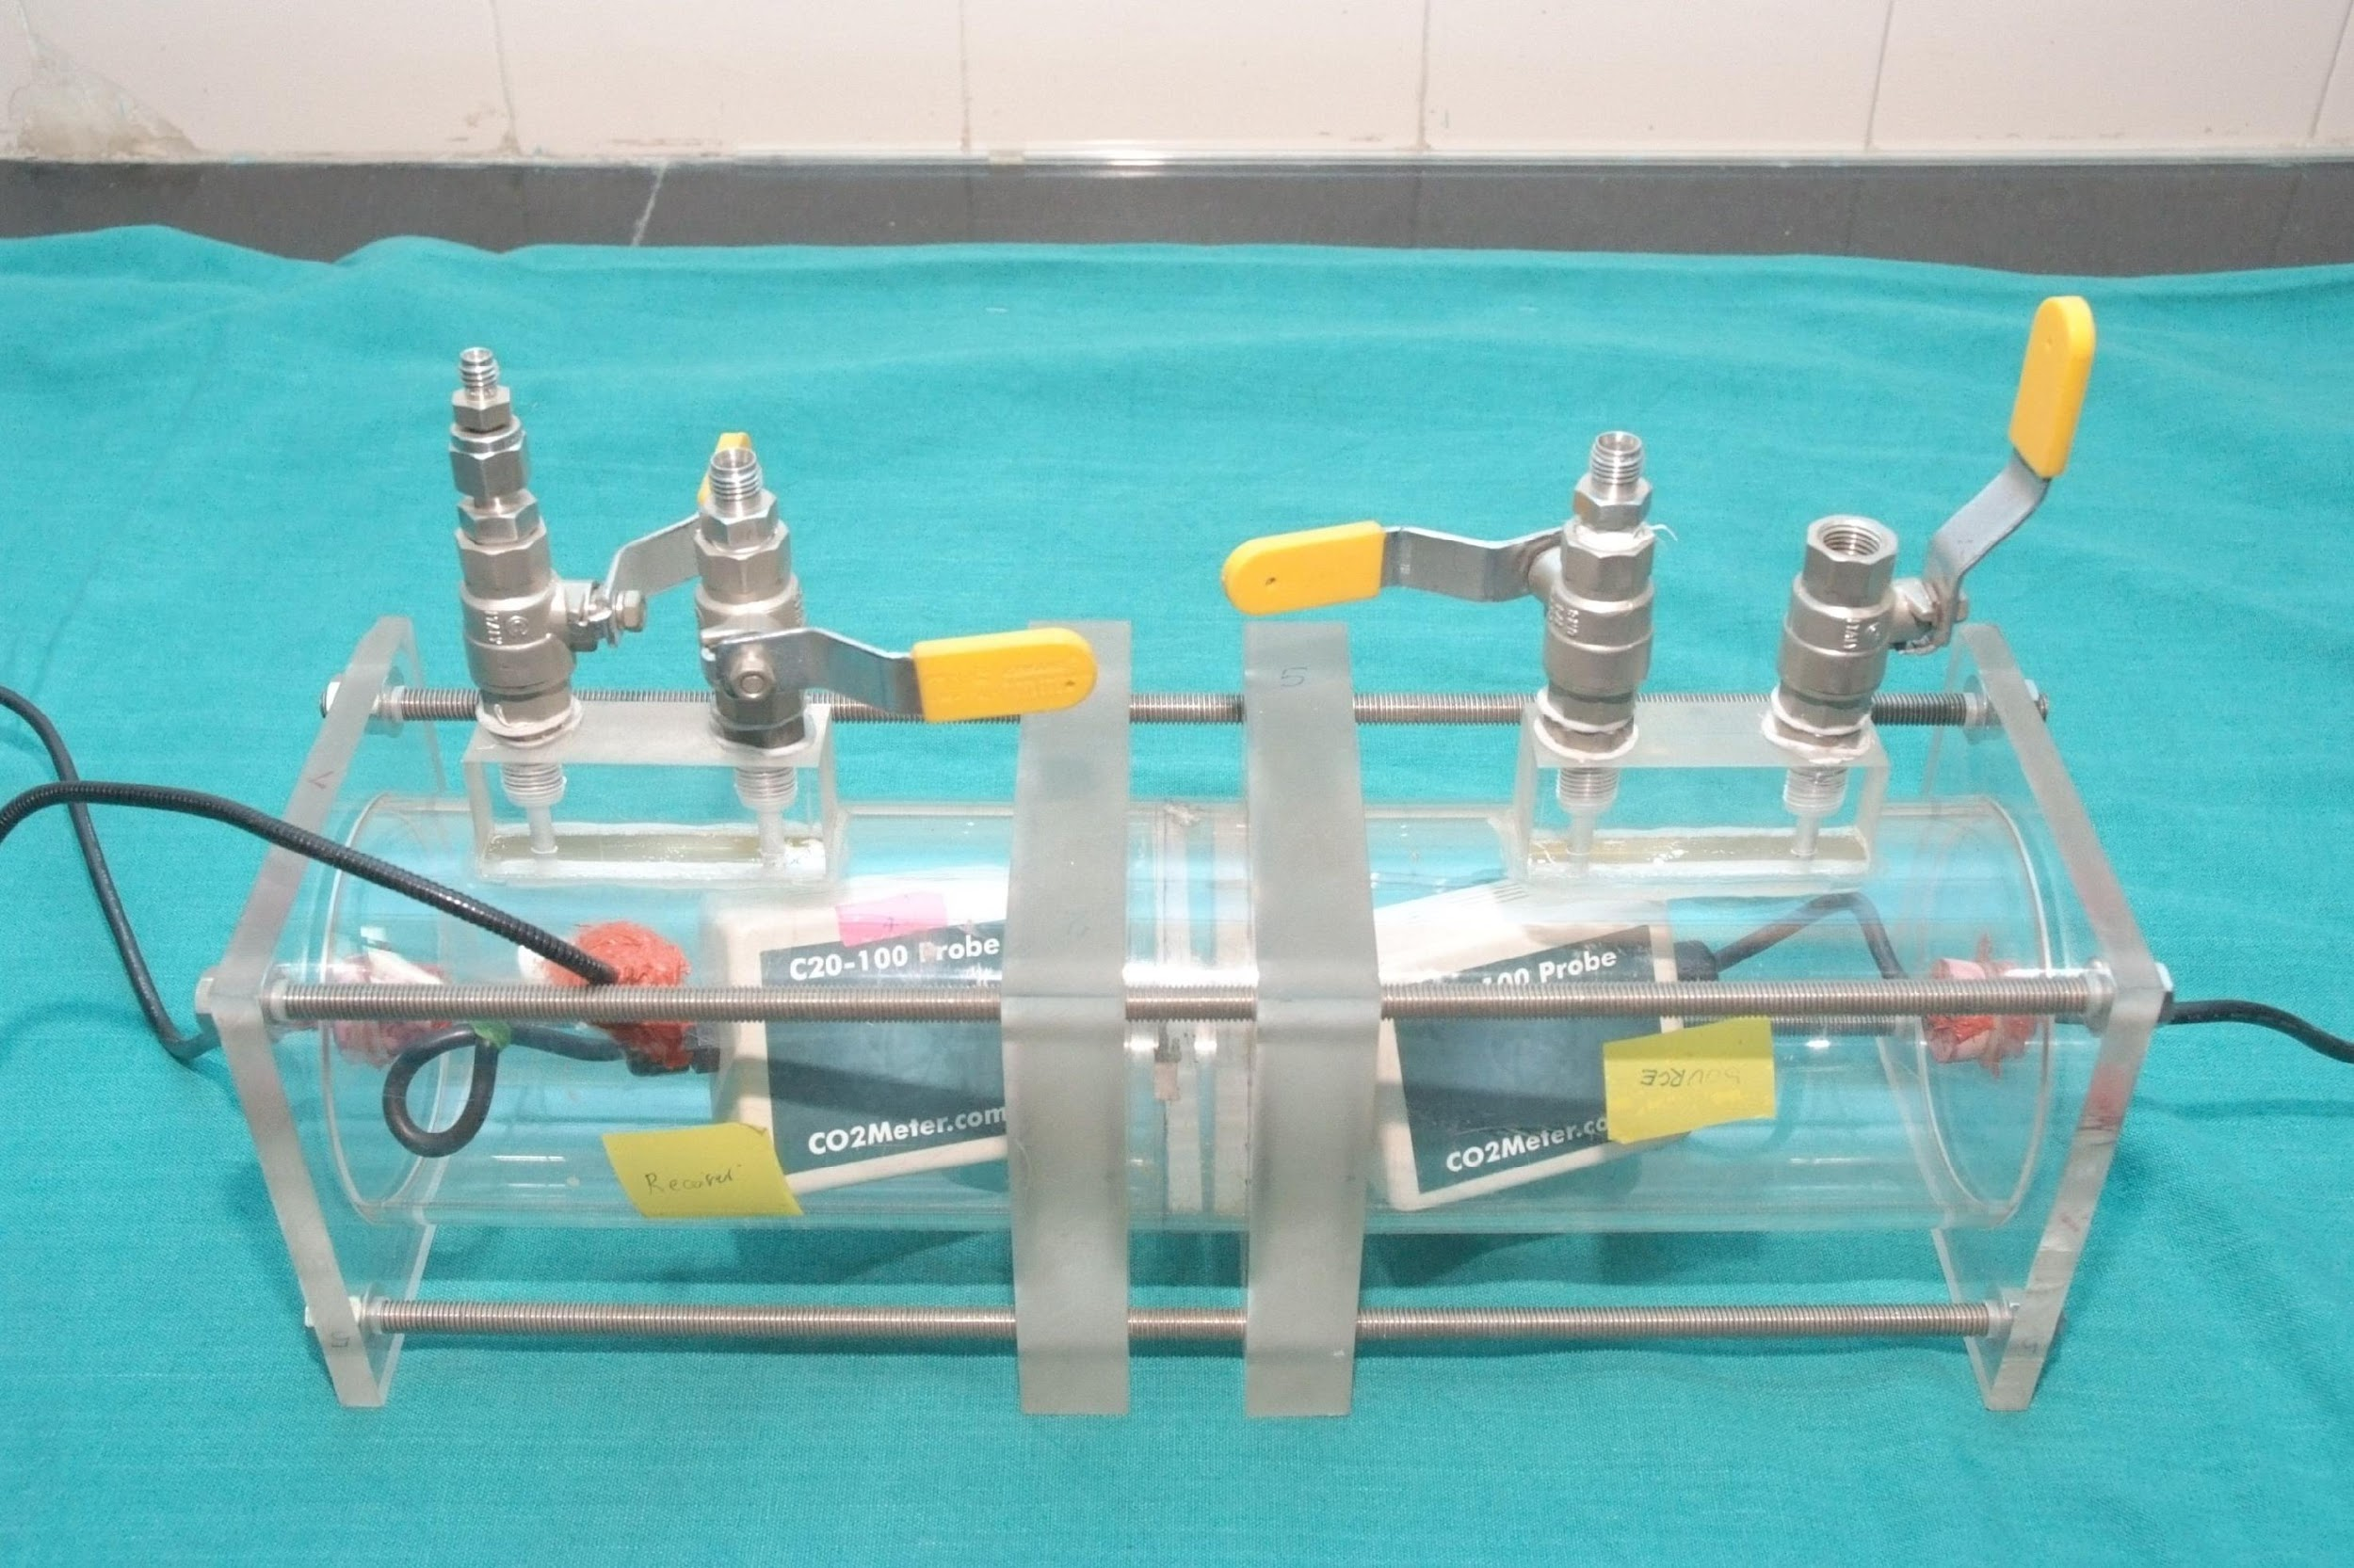
Fabricated Carbon dioxide Diffusion cells
Working Principle
The carbon dioxide sensors kept at the source and receiver end measures the variation in the concentration of gas and hence the rate of diffusion
Application
Carbon dioxide diffusion measurement
To estimate the coefficient of carbon dioxide gas diffusion through a compacted geomaterial

