Slide 1
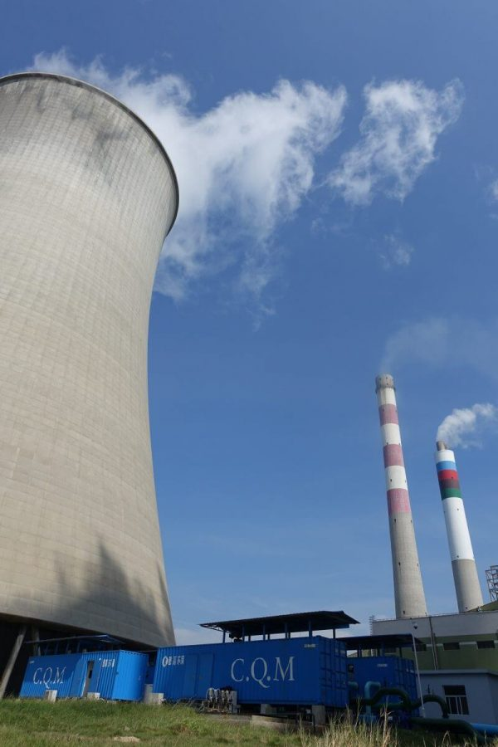
CE 5120 Maintenance and Rehabilitation of Constructed Facilities
Course Project on
Retrofitting of RCC structure of new cooling tower,
IOCL Gujarat Refinery
Anupama V. A.
CE19D034
Nilakanmani Manimaran
CE19D038
Ramakrishna S.
CE19D033
Images are sourced from internet for illustration purpose

Slide 2
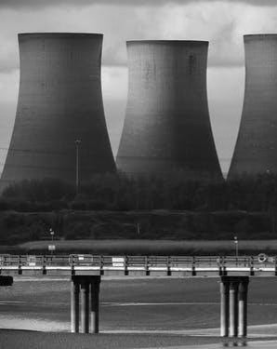
OVERVIEW
Project Introduction
Problem Identification
Assumptions
Objectives
Schedule
Expected outcomes
References

Slide 3
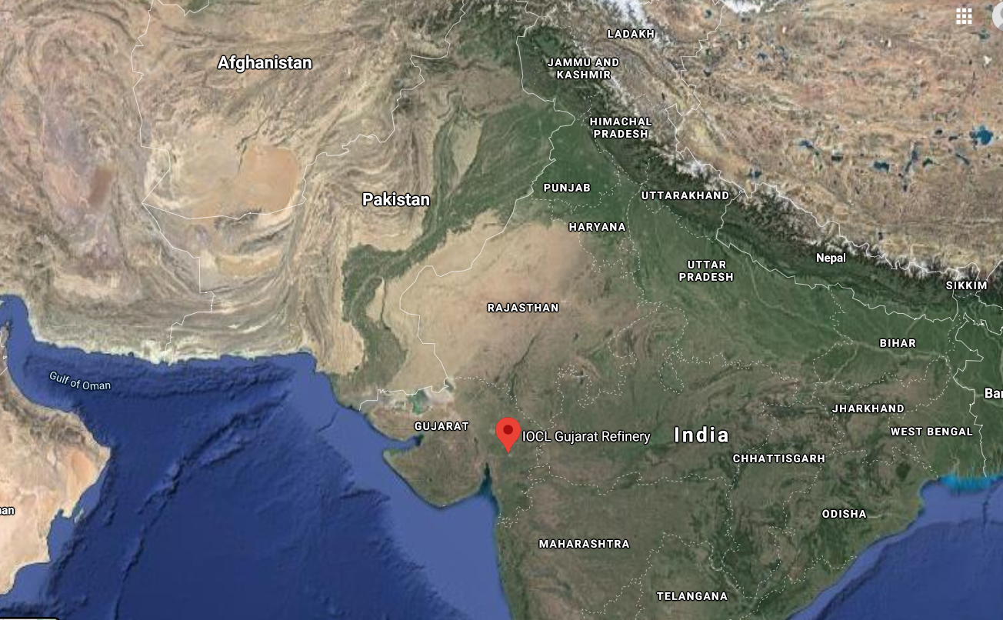
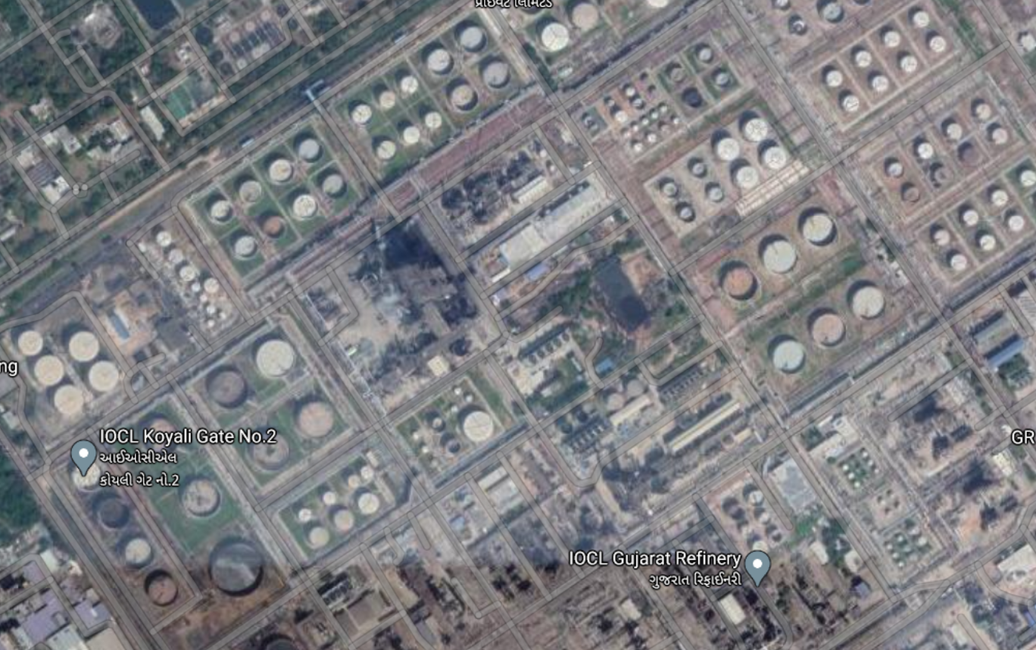
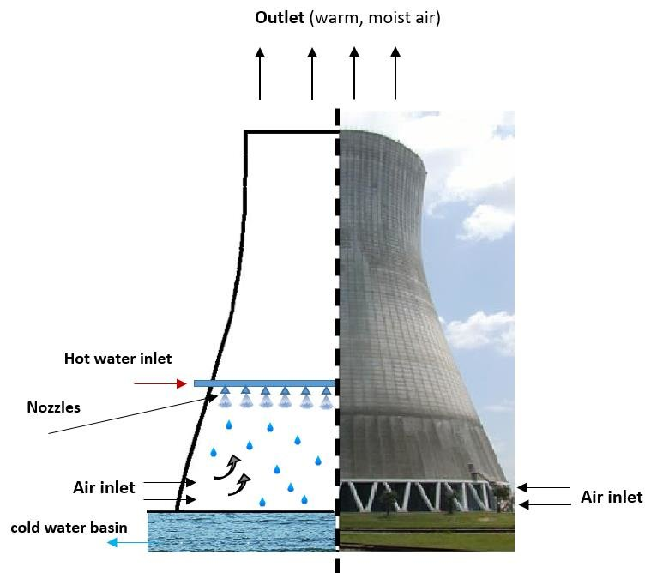
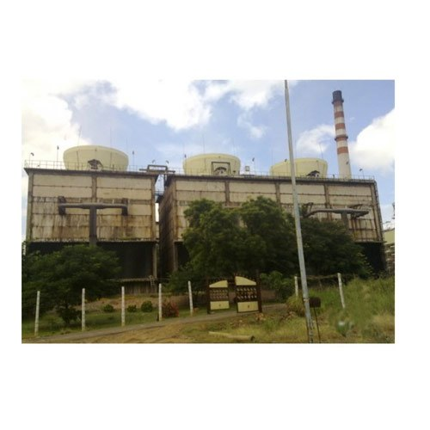
INTRODUCTION
COOLING TOWER
b
FRP/RCC
a
c
Founded: 1966
Owner: IOCL
Operating units: 40
Capacity: 13.7 MMT per year
Susceptibility to reinforcement corrosion

Slide 4
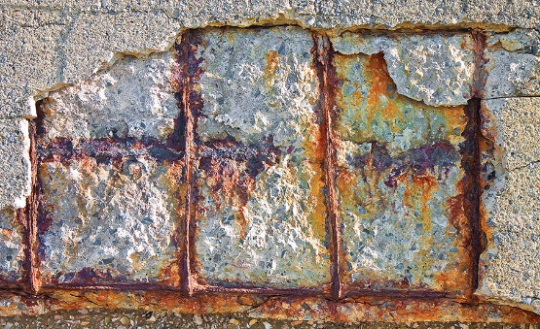
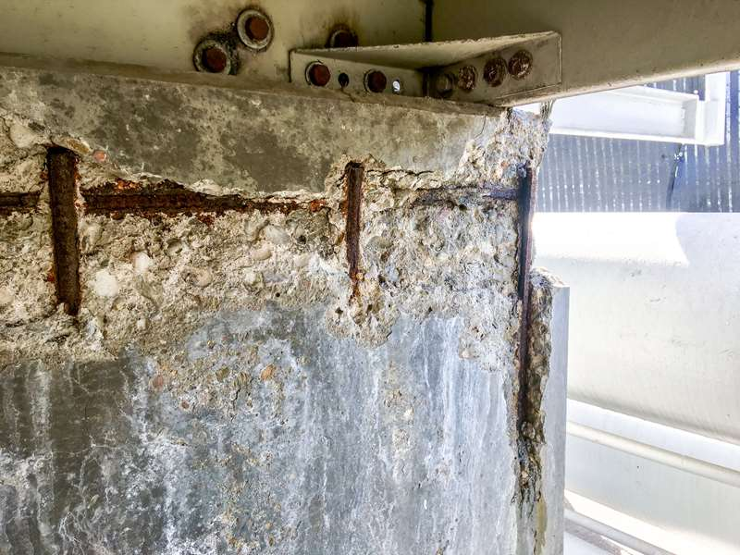
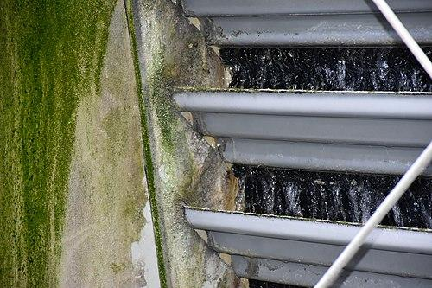
PROBLEM
The representative photographs of corrosion in cooling tower
Biological growth in cooling tower
Exposed corroded rebars, cracks, spalling, delamination and biological growth

Slide 5
ASSUMPTIONS
Construction
Cooling Tower
Problems
Site Conditions
Coordinates:
22°22'13.80"N 73°07'31.80"E
Nearest city: Vadodara
Humidity: 60%
Temperature: 15°C - 35°C
Proximity to coast: 30 km
Grade of concrete:
M25(columns, shells)
M20 (other members)
Rebars: CTD bars
Cover depth: 25 mm
Pile foundation
Water source: Mahi river
Type: Natural draught
Material: RCC
Filler material: Polypropylene (63 mm x 63 mm, 9MFI)
Supply Voltage: 380 V
Supply Phase: Three phase
Early age cracks
Fresh water leaching
Carbonation (suitable humidity, higher atmospheric concentration of CO₂ and high local Temperature)
High TDS in recirculating water
Biological growth

Slide 6
OBJECTIVES
Recommend condition assessment procedure to identify the root cause of distress and extent of damage
Develop repair and retrofitting strategies for the structural elements of a heavily corroding cooling tower
Revise the tender specification with durability design to achieve the target service life

Slide 7
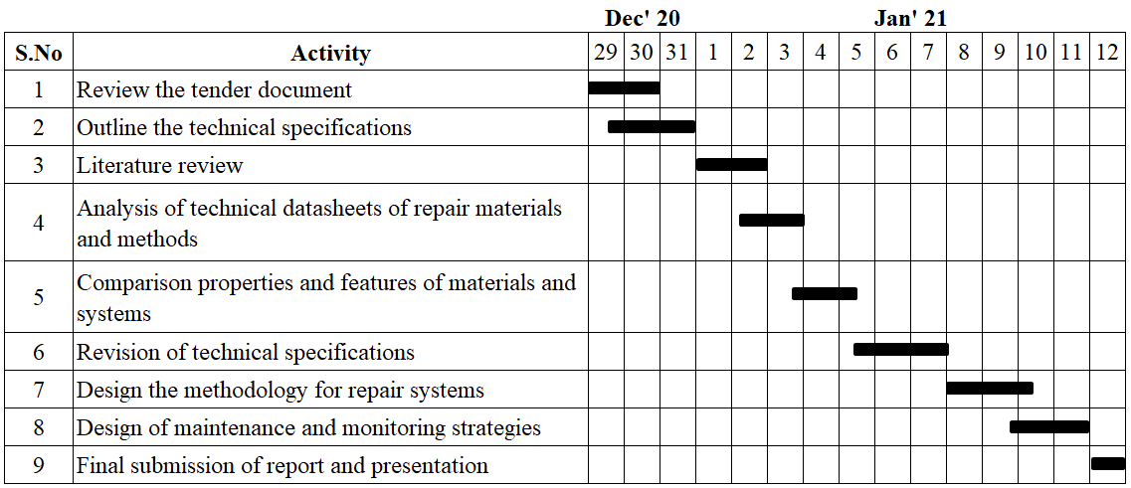
SCHEDULE

Slide 8
OUTCOMES
The primary outcome is to recommend tender specification, which can ensure the structure to achieve its targeted service life after repair
The other outcomes are
Revised tender specification including strength and durability approach
Repair methodology and preventive maintenance strategy
Extended corrosion-free initiation phase and enhanced service life
Ensured safety, functionality and aesthetics of the structure

Slide 9
REFERENCES
https://spxcooling.com/wp-content/uploads/AE-SK-18.pdf
https://www.indiamart.com/proddetail/rcc-cooling-tower-4823753530.html
https://www.oilandgasproductnews.com/article/28534
http://spxcooling.com/wp-content/uploads/Cooling-Tower-Fundamentals.pdf
https://iocl.com/AboutUs/GujaratRefinery.aspx
Tender documents for Retrofitting of RCC structure of TPS new cooling tower at Gujarat Refinery.

Slide 10
THANK YOU

