Slide 1
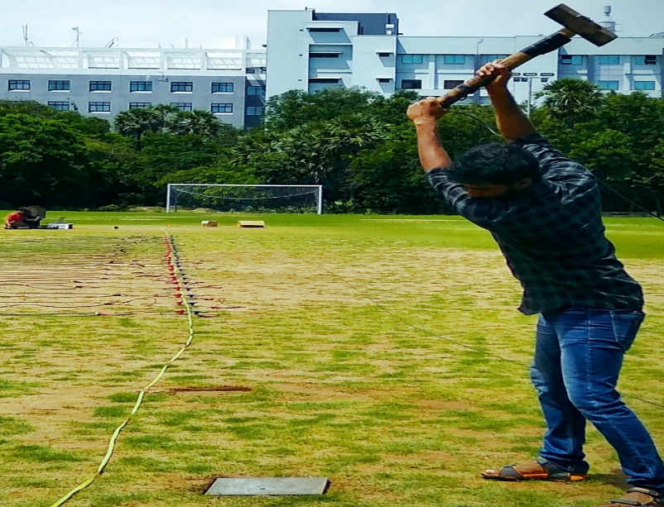
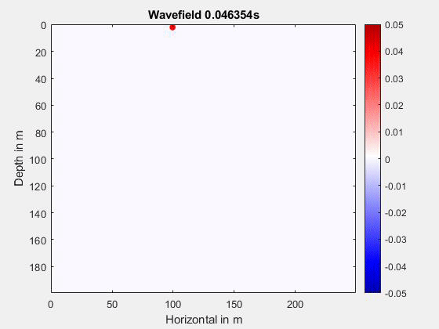
Surface Wave Testing
Working Principle
The wavefield radiated by seismic tremors contains surface waves which are dispersive in nature.
Surface wave testing
Application
Dispersive properties of Rayleigh wave is used in Multichannel Analysis of Surface Wave (MASW) to obtain the subsurface's shear wave velocity profile.
Numerical simulation of wavefield

Slide 2
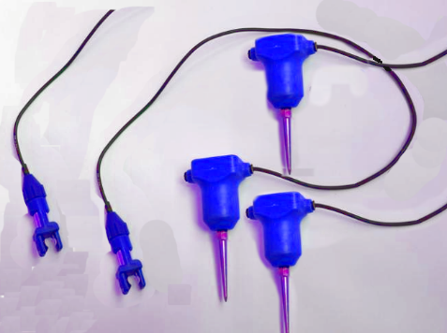
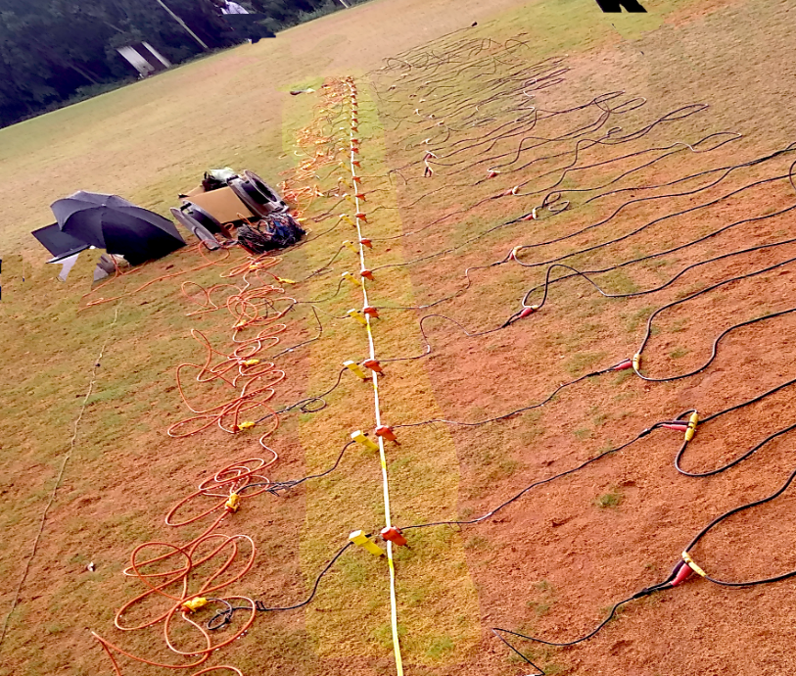
Geophones
Working Principle
The geophone’s magnetic core and coil system converts the ground motion into electrical voltage.
4.5 Hz geophones
Application
Used to measure low frequency vertical as well as horizontal ground motion. Usually an array of 24-48 geophones is used in multichannel analysis.
24 Channel receiver array

Slide 3
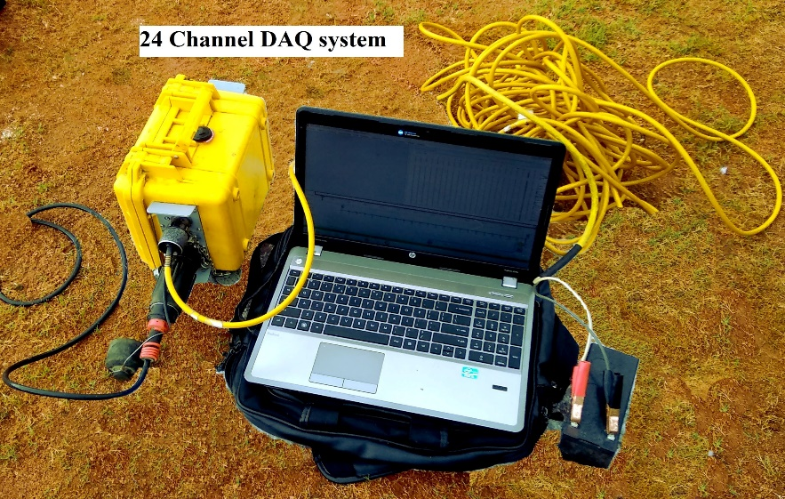
Data Acquisition System
Working Principle
Collect and store multichannel receiver signal.
24 channel DAQ system
Application
Converts the analog signal to a discrete digital signal with a very high sampling rate and stores the common shot gather.
Multichannel shot gather

Slide 4
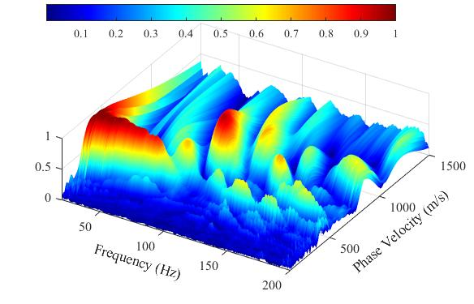
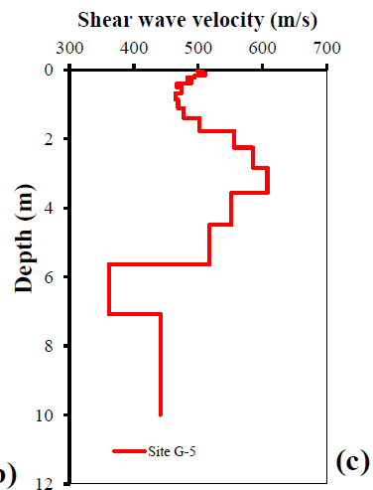
Analysis tools
Working Principle
Mathematical wavefield transformation tools decompose the recorded data into their frequency-dependent phase velocities.
Multimodal dispersion graph
Application
Used to obtain a high-resolution multimodal field dispersion image that will act as a reference in inverse analysis.
Shear wave velocity profile

